Slide 1
Eficiência de Custos
em DevOps
Julio Faerman @faermanj

Slide 2
“If you can’t feed a team with two pizzas, it’s too large”
- Jeff Bezos, ~2001
Notes:
Two-pizza teams
Full Ownership
Full Accountability
Aligned Incentives
“DevOps (aka: you wrote it you run it)”

Slide 3
Strangling the Monolith
DNS
CDN
LB
Zuul
…
Router
Router
SYSHUGE
SYSHUGE
SMALL
SERVC

Slide 4
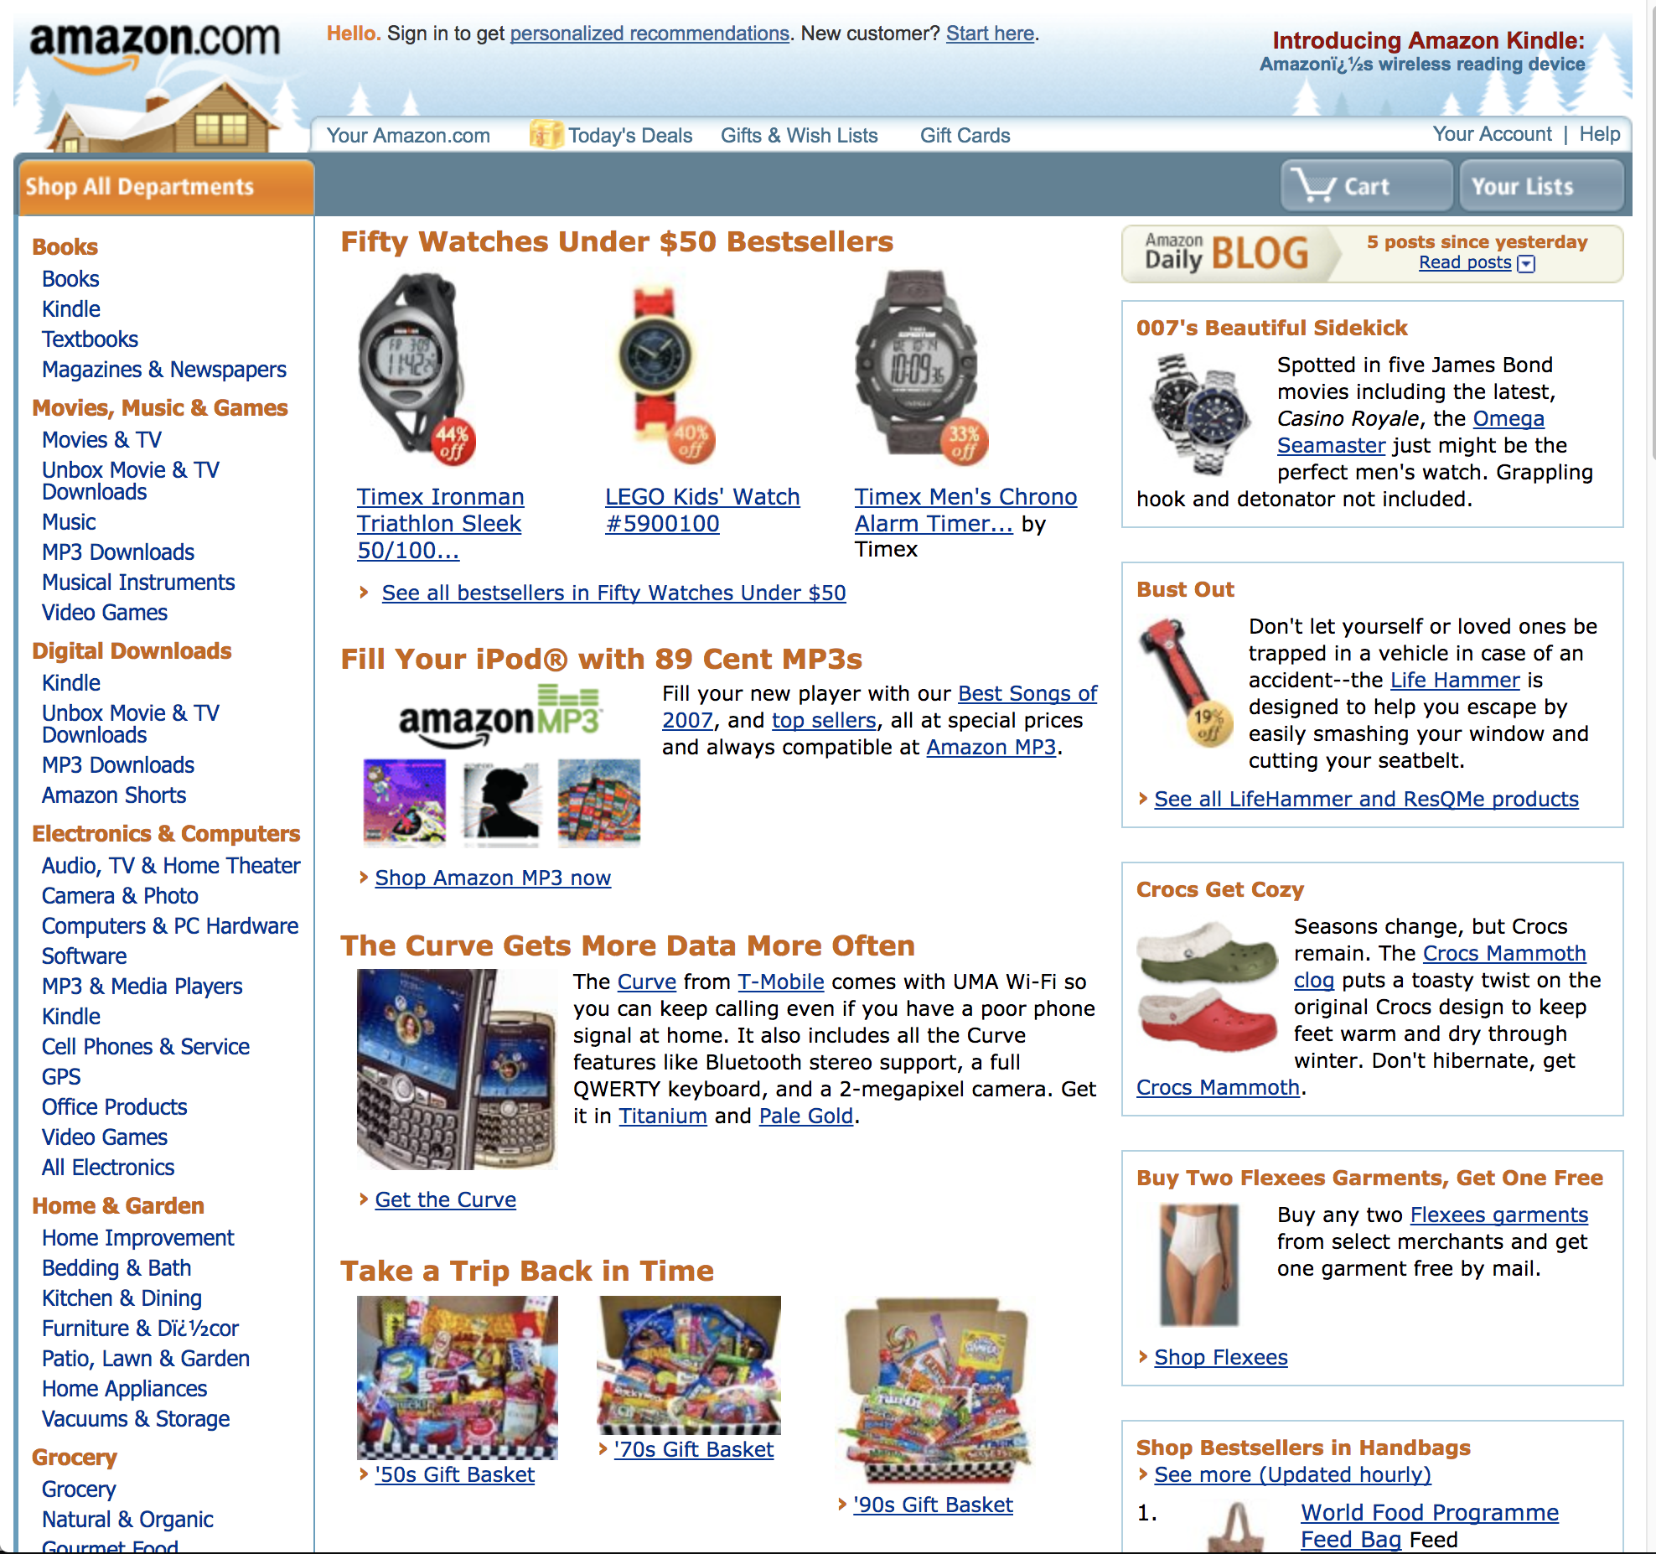
``
Notes:
2008

Slide 5
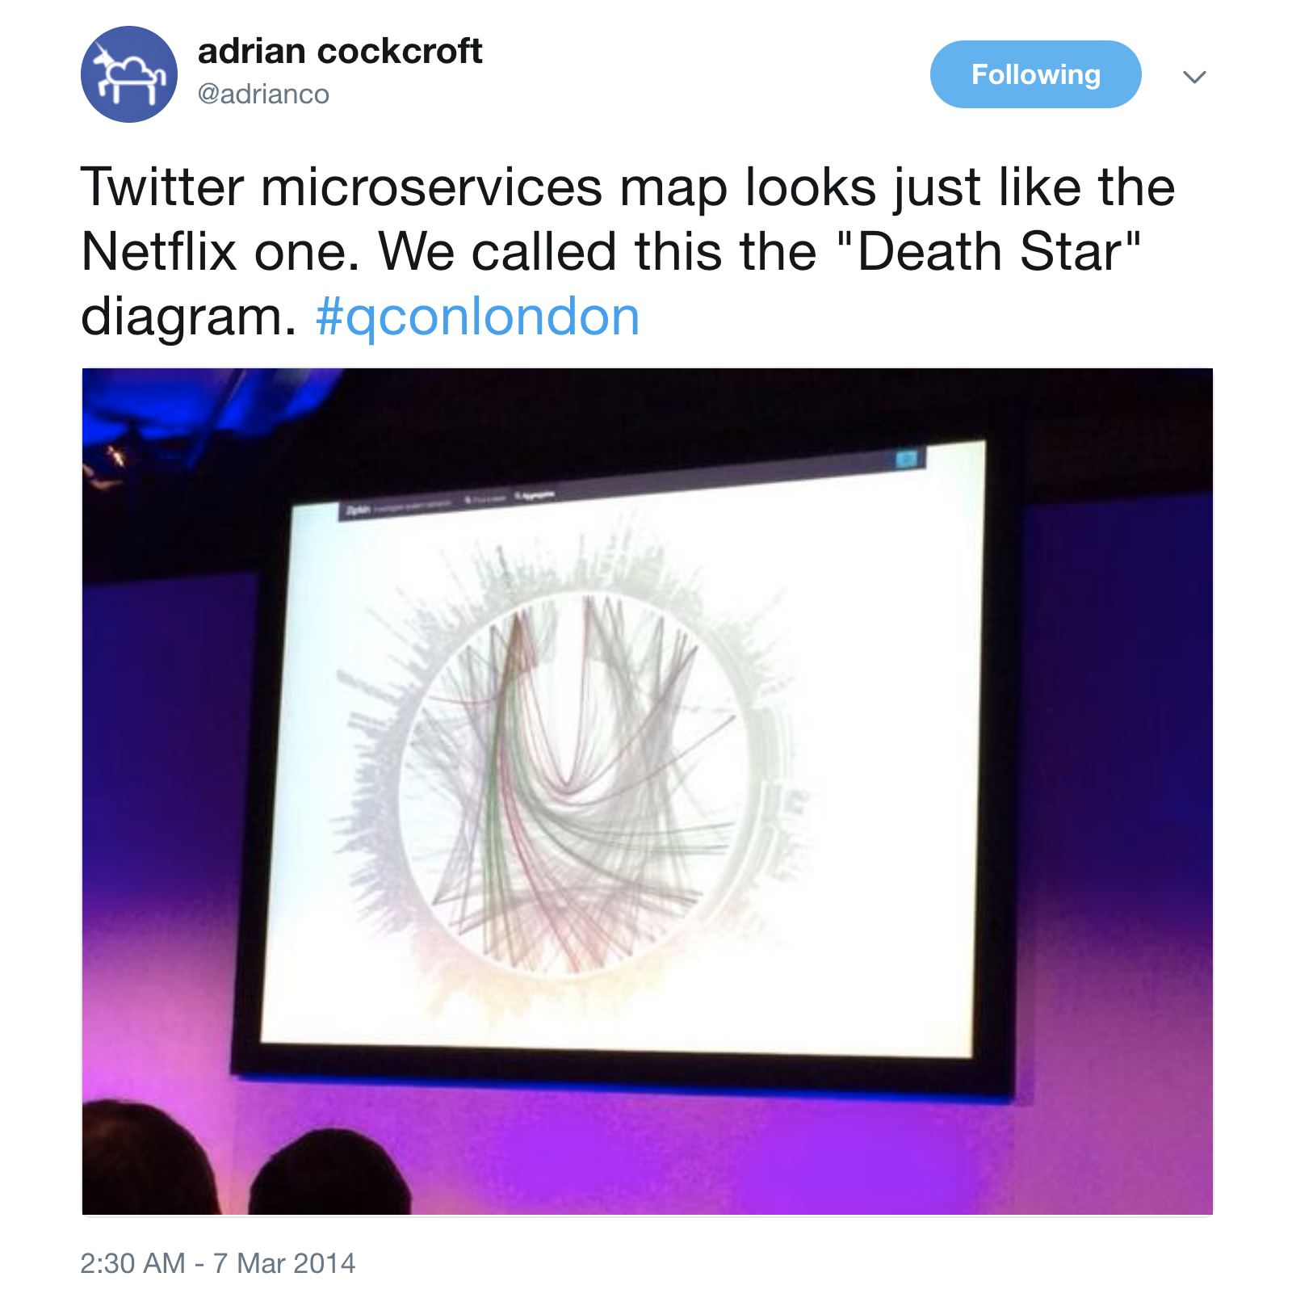
``

Slide 6
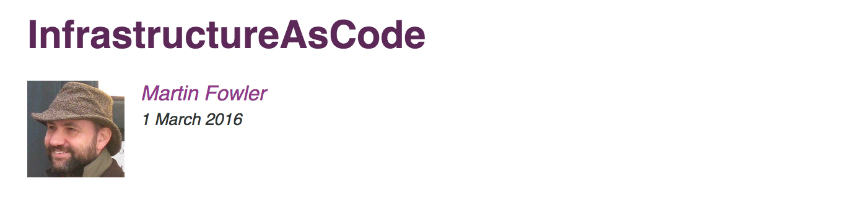
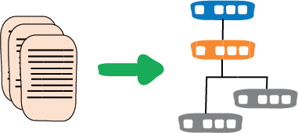
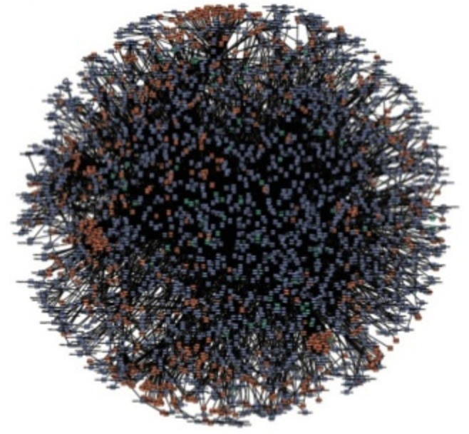

”…a necessary capability if you're moving to a serious adoption of microservices.”

Slide 7
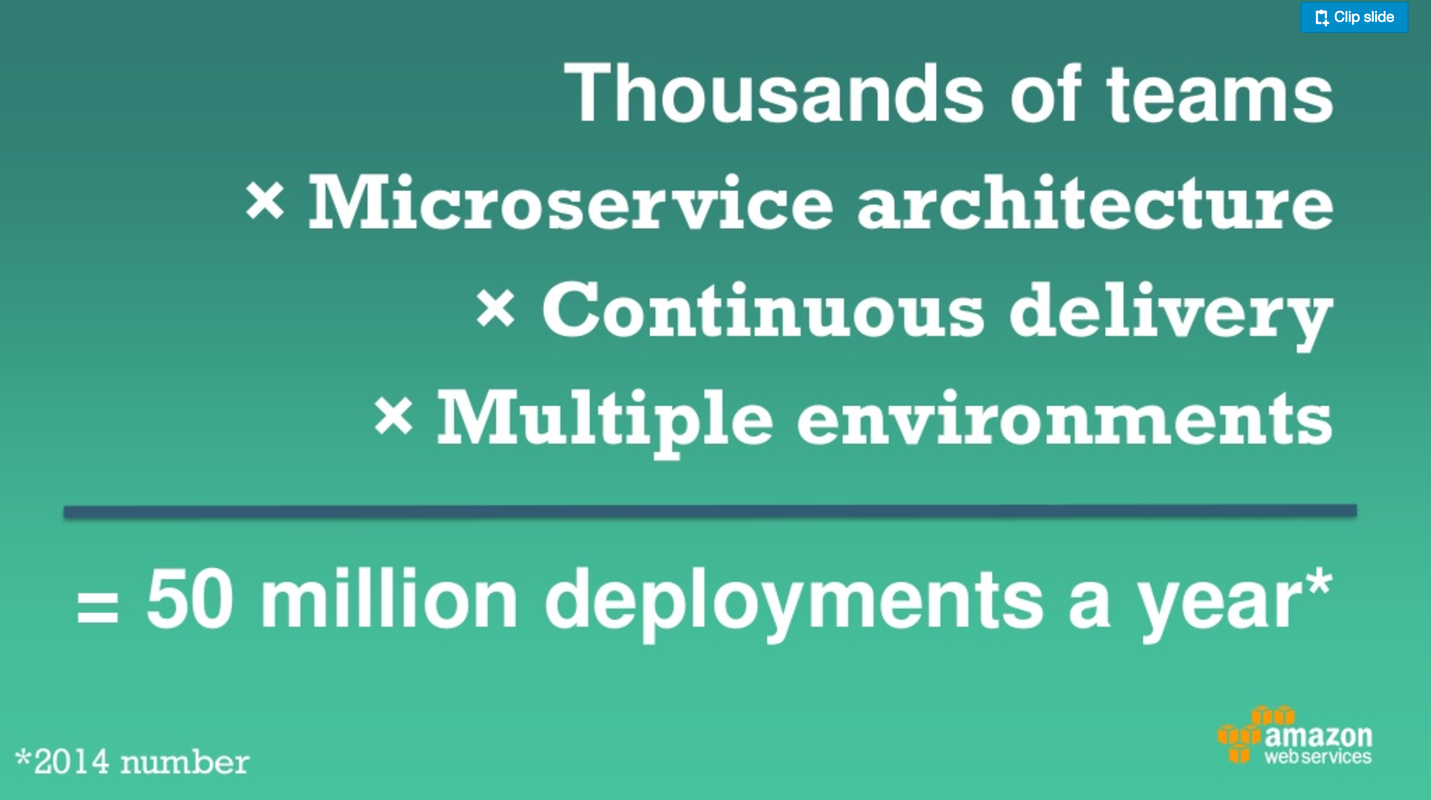
~=> 1 / 1.58s
Notes:
” DevOps @ Amazon: Microservices, 2 Pizza Teams, & 50 Million Deploys a Year”
From https://www.youtube.com/watch?v=DBluxFsvksk
50000000/(365*24*60*60) =

Slide 8
Infrastructure as Code
https://aws.amazon.com/whitepapers/

Slide 9
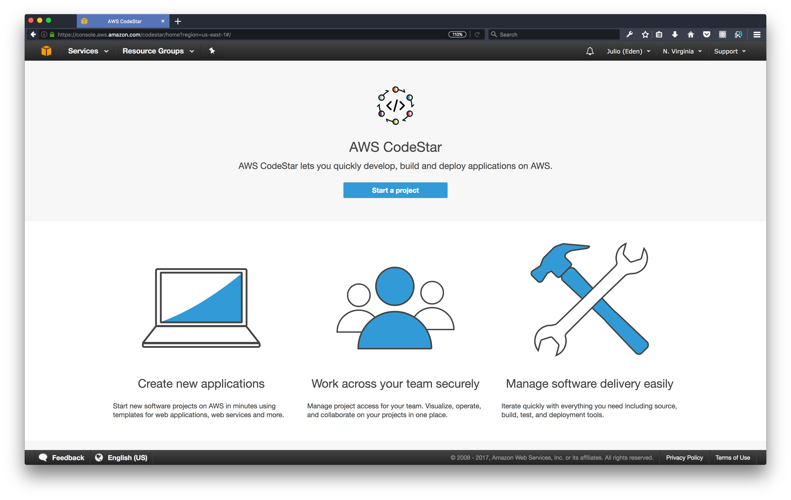

Slide 10
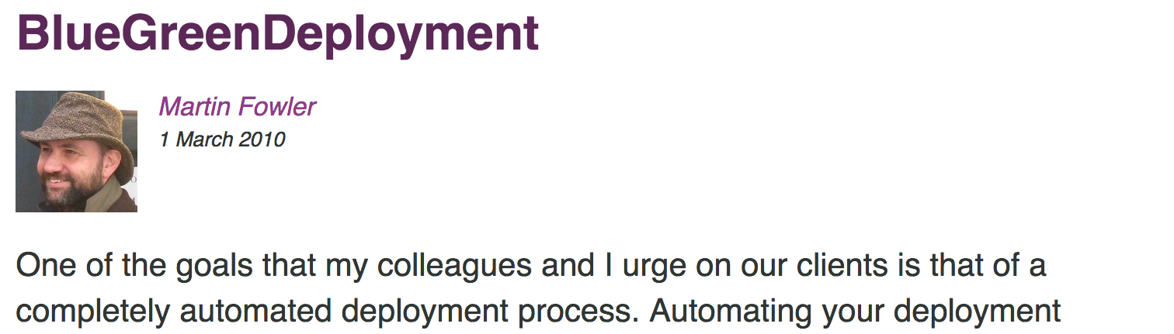
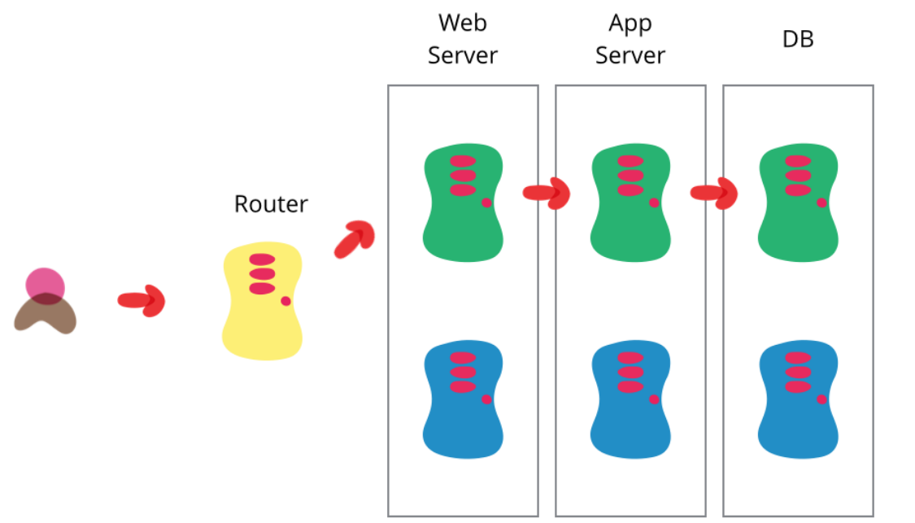

Slide 11
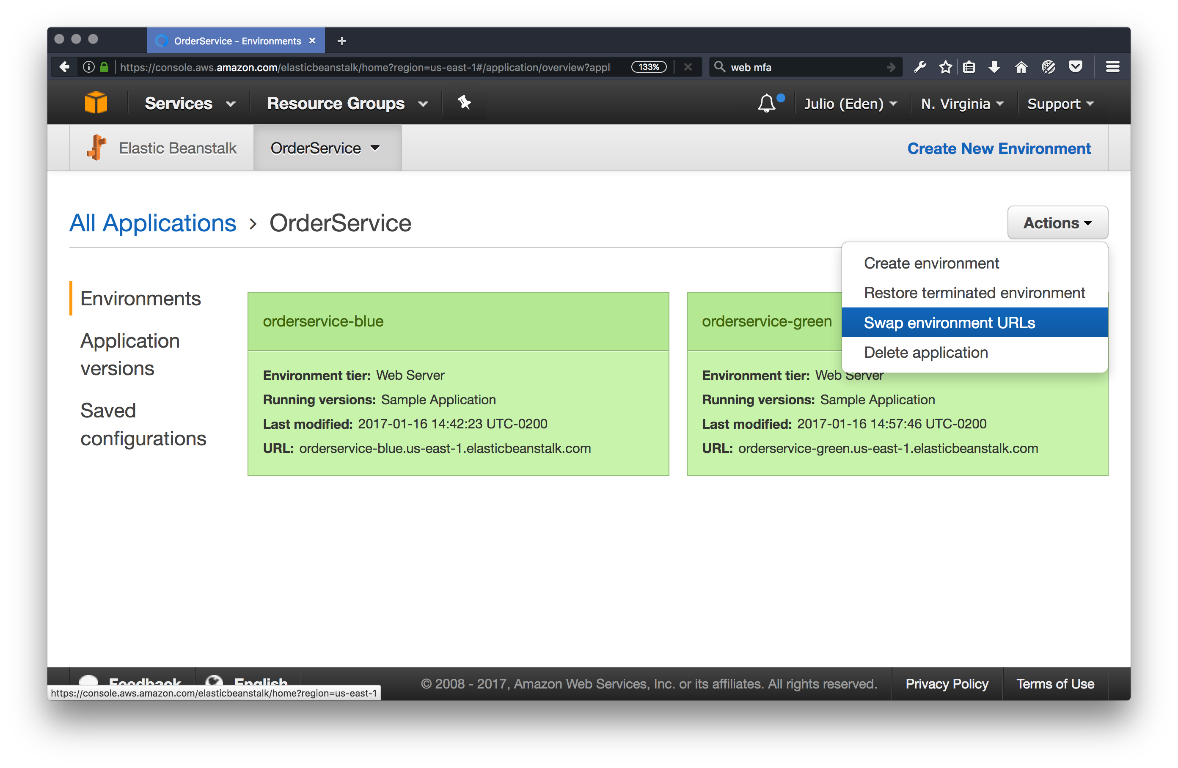

Slide 12
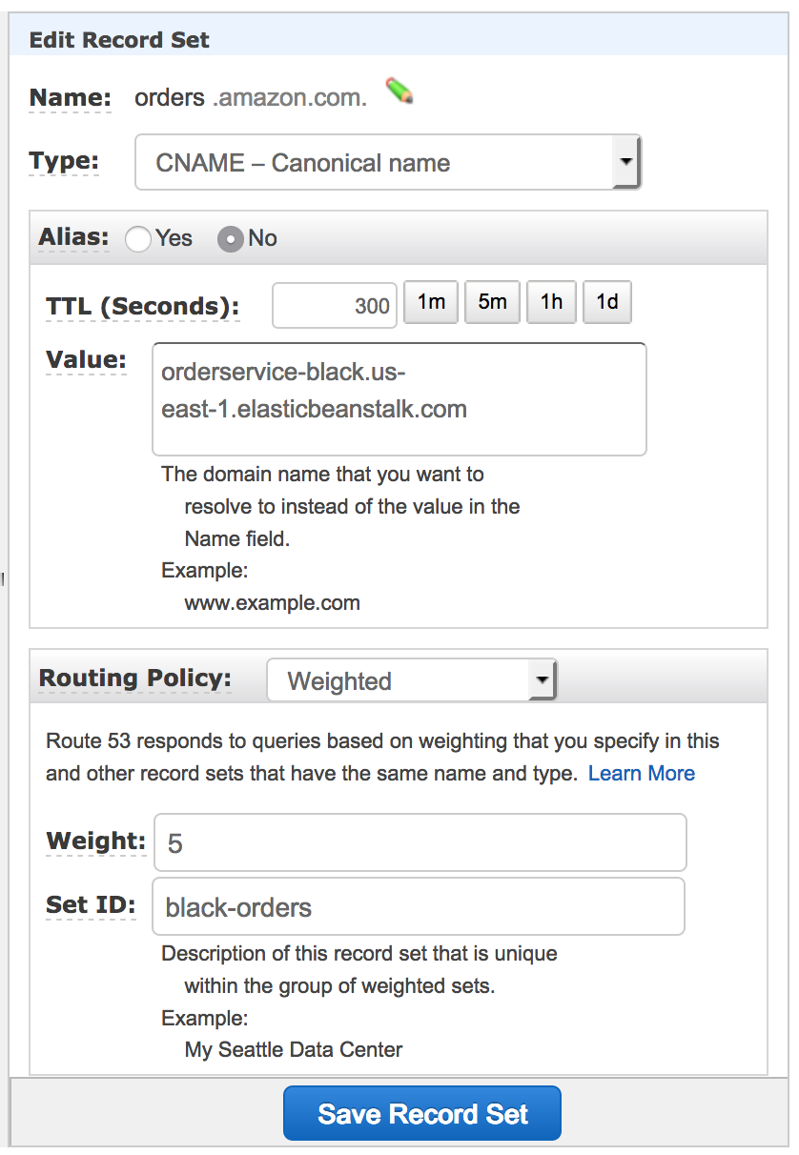
Healthy Production Environments
Notes:
Canaries image from https://www.pinterest.com/wajdielbez/canaris/

Slide 13
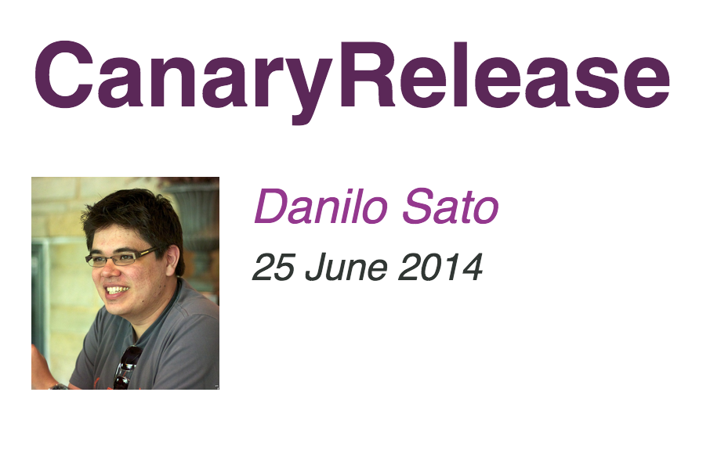
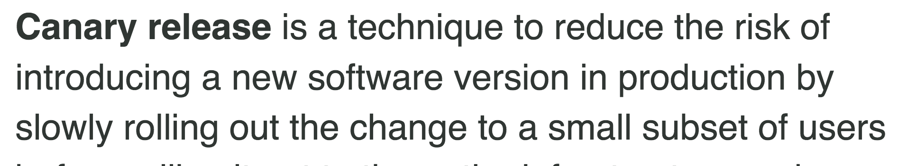
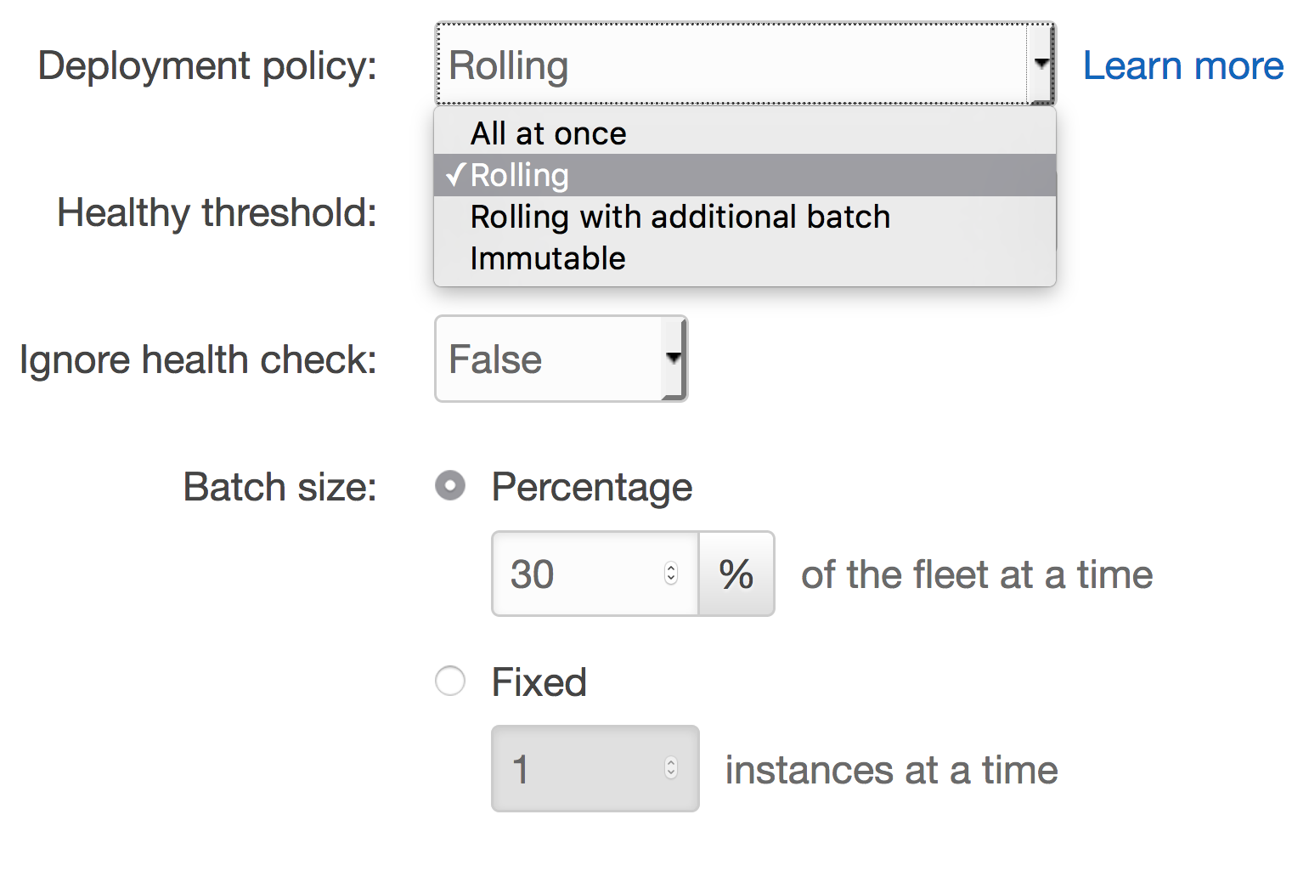
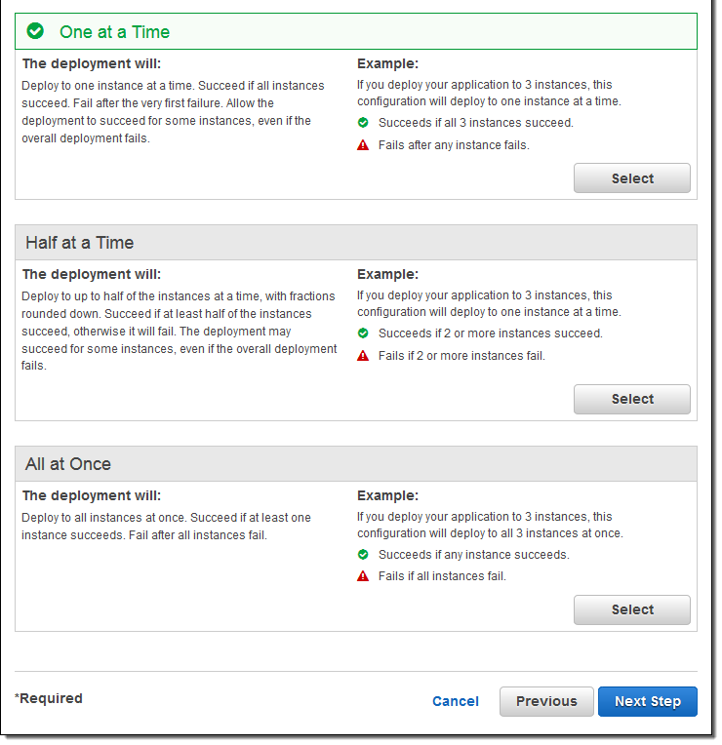

Slide 14
``

Slide 15
Custom
Drift
LEGACY

Slide 16
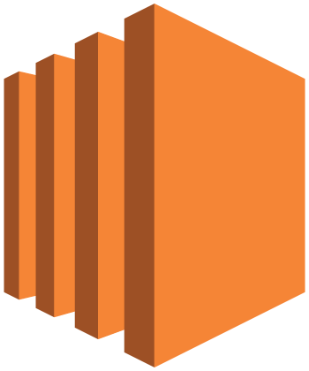
Provisioning
Configuration
Deployment
AWS
OpsWorks
AWS EC2
Systems Manager
AWS
CodeDeploy
Notes:
On-Premises Icon from http://www.fpweb.net/public/images/silos/managed-sharepoint/on-prem.png
References:
https://martinfowler.com/bliki/ConfigurationSynchronization.html

Slide 17
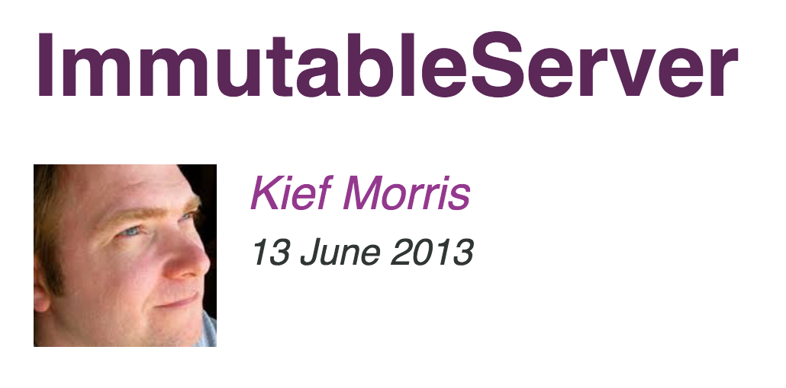
“…An Immutable Server is the logical conclusion of this approach, a server that once deployed, is never modified, merely replaced with a new updated instance.”
Provisioning
Configuration
Deployment

Slide 18
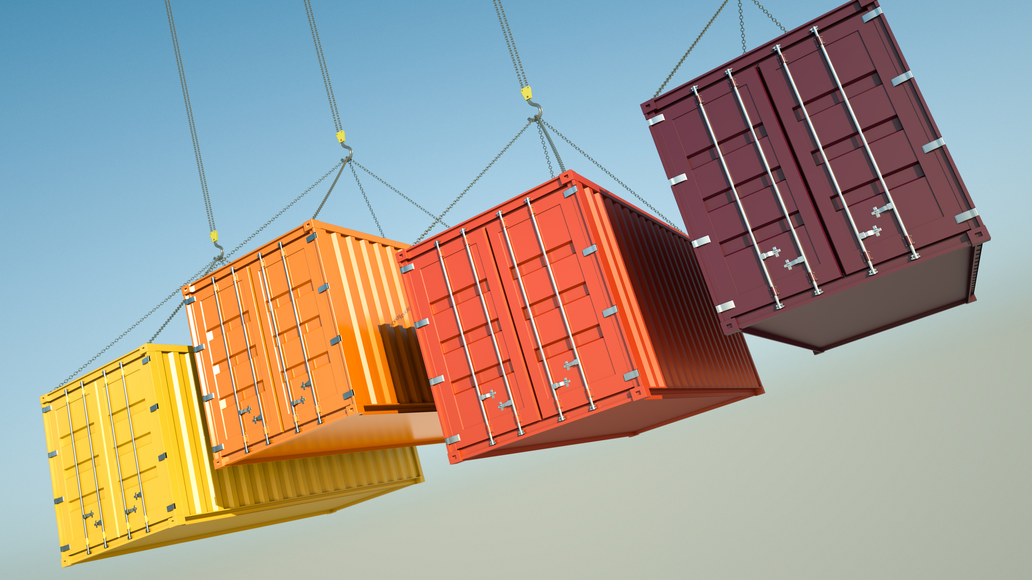


Slide 19
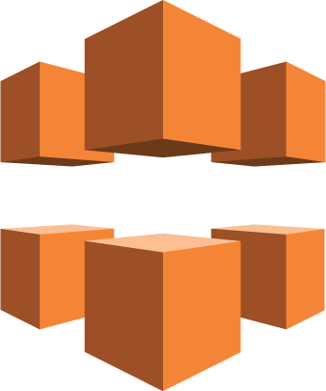
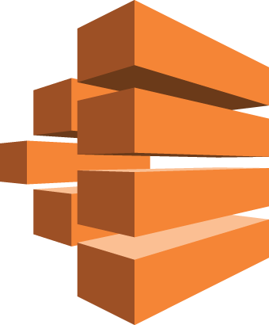
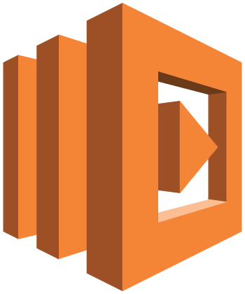

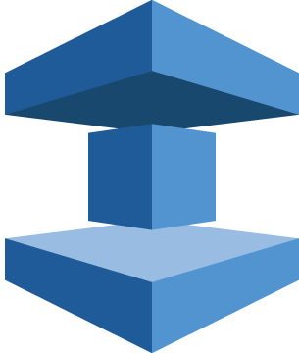

Amazon CloudFront
+
AWS Batch
AWS
Lambda
Amazon
DynamoDB
Amazon
ElastiCache
Amazon
RDS
...

Slide 20
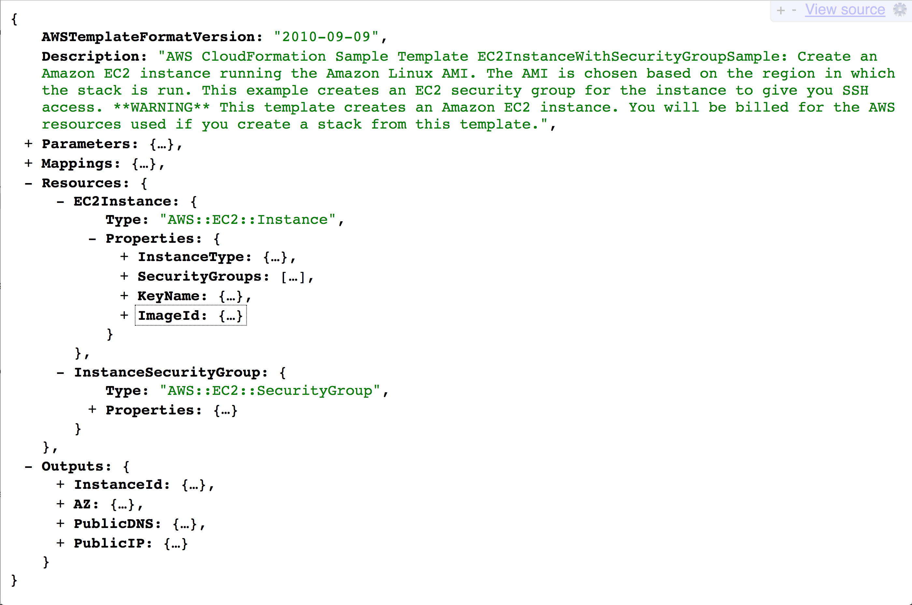

AWS CloudFormation

Slide 21
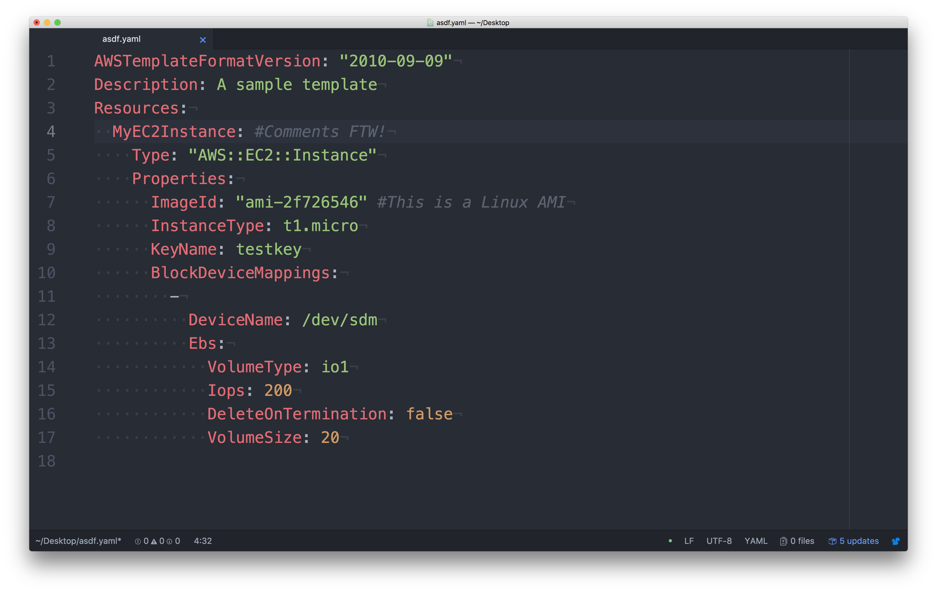
``

Slide 22
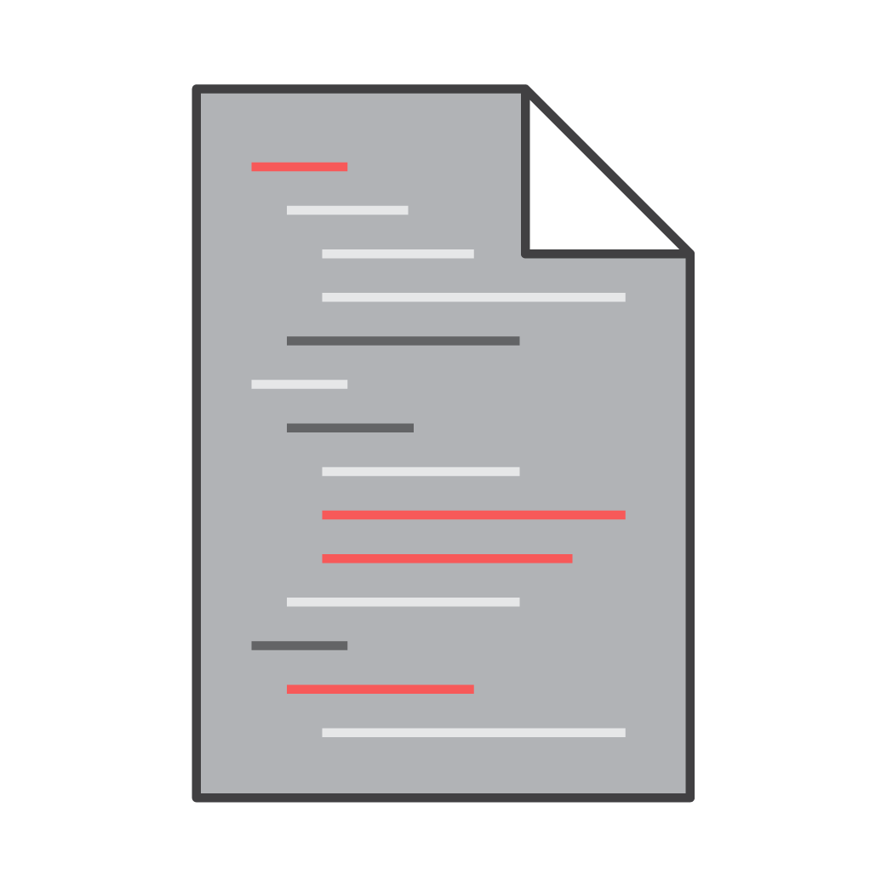
Cross Stack References
Network Stack
Outputs:
VPC
Description: reference VPC
Value: !Ref VPC
Export:
Name: ProdVPC
App Stack
Resources:
myTargetGroup:
Type: AWS::ELBV2::TargetGroup
Properties:
VpcId:
Fn::ImportValue: ProdVPC
Notes:
AWS re:Invent 2016: Infrastructure Continuous Delivery Using AWS CloudFormation (DEV313)

Slide 23
Nested stacks
Application
Resources:
NetworkResources:
Type: AWS::CloudFormation::Stack
Network Resources
Resources:
MyVPC
Type: AWS::EC2::VPC
ECS Service
Resources:
MyService:
Type: AWS::ECS::Service
Notes:
AWS re:Invent 2016: Infrastructure Continuous Delivery Using AWS CloudFormation (DEV313)

Slide 24
 | Nested Stacks | Cross Stack References
Recommended uses cases
Advantages
Considerations
Template reuse
Use multiple templates but manage as single stack
Sharing common resources
Allows for independent stacks based on resource lifecycle or ownership.
Convenient management. One stack manages all resources and nested stacks.
Creation order and dependencies are managed
Separation of concern
Share databases and VPCs
Lets you limit blast radius with safeguards
Updates and rollbacks have a wide surface area
Reusing templates that have custom resource names
Replacing updates requires changes to the importing stacks to execute.
Does not manage creation order
Notes:
AWS re:Invent 2016: Infrastructure Continuous Delivery Using AWS CloudFormation (DEV313)

Slide 25
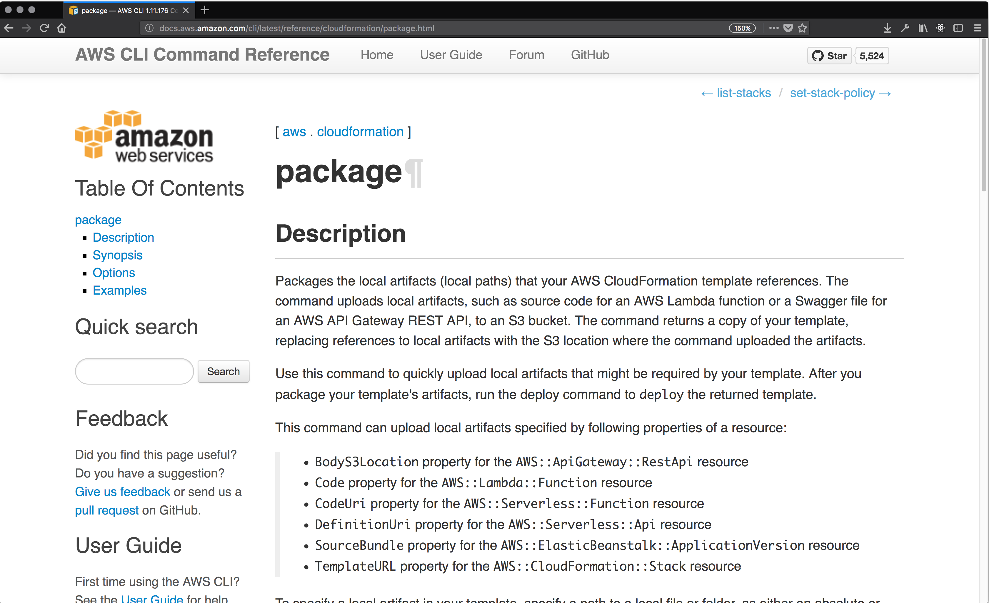
``

Slide 28
Infrastructre as Code as Code…
AWS::CodeCommit::Repository
AWS::CodeBuild::Project
AWS::CodePipeline::Pipeline
AWS::CodePipeline::CustomActionType
AWS::CodeDeploy::Application
AWS::CodeDeploy::DeploymentGroup
Notes:
Who updates the self update?

Slide 29


aws.amazon.com/twitch
twitch.tv/aws

Slide 30
Thank you!
Julio Faerman @faermanj

