Slide 1
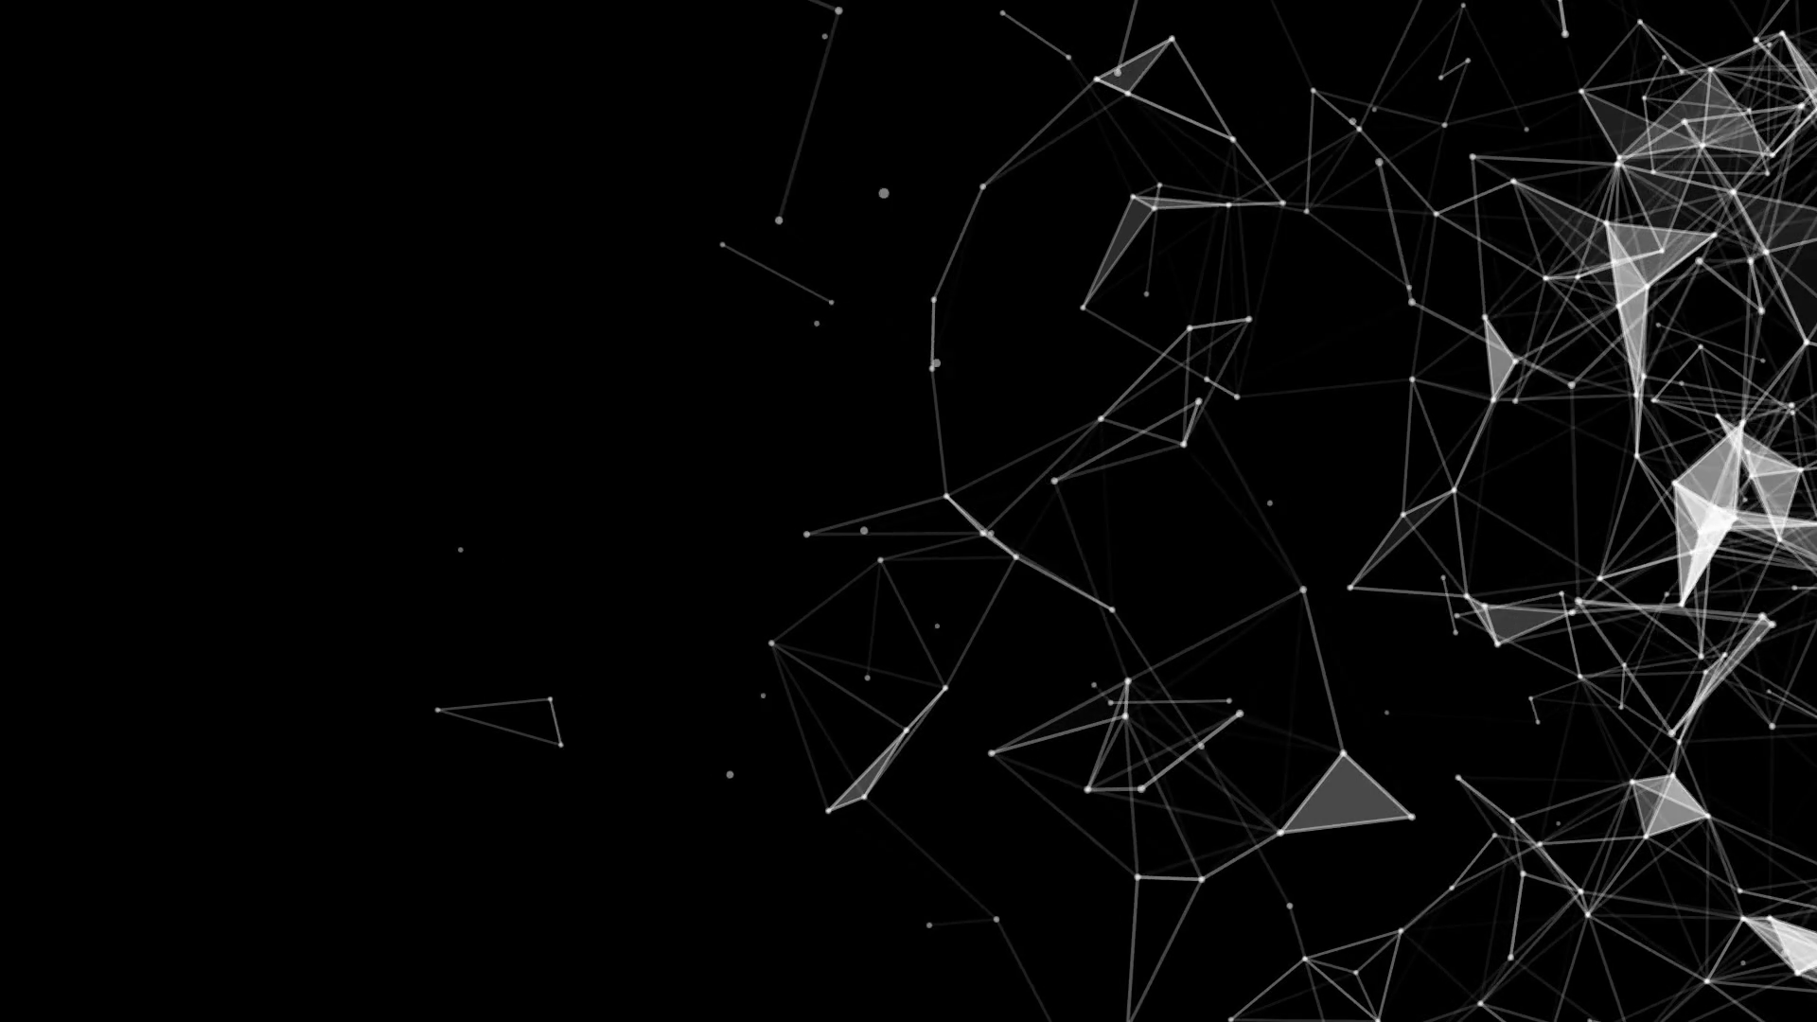

POR QUE ESSE CONTAINER
NÃO RODA?
HÉVELLYN GOMES
TRILHA CONTAINERS
WHY THIS CONTAINER DOES NOT RUN?
TOP 4

Slide 2



Slide 3



HÉVELLYN GOMES
Technical Support Engineer @ Red Hat
Certified OpenShift specialist
/hevellyngomes
hevellyn.nlg@gmail.com

Slide 4
AGENDA
Why this container died?
Why this container *did not* die?
Why is it so slow?
Why so many storage issues?
feat. DeviceMapper vs Overlayfs
Notes:
Como suporte técnico, e com background em OPS, a verdade é que trabalhando com uma ferramenta como essa, eu preciso navegar entre várias camadas, que vão desde o Sistema Operacional, Container Runtime, Kubernetes, OpenShift que empacota esse todo. Então pegando o contexto de container seja ele as vezes relacionado com Kubernetes ou não, eu condensei o que eu vi que são os problemas mais comuns nesse na visão de sysadmin. A ideia é compartilhar com vocês algumas possíveis causas, insights, e passos de troubleshooting para esses problemas mais frequentes.. E a maneira que a gente vai fazer isso é através de 4 perguntas:

Slide 5

POR QUE ESSE CONTAINER
NÃO RODA?
WHY THIS CONTAINER DOES NOT RUN?
TOP 4

Slide 6
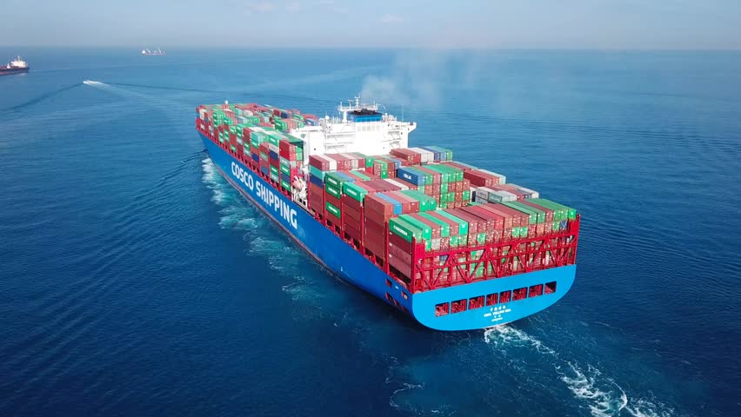
Notes:
O fato é que uma solução como PaaS ou orquestrador costuma ser mais interessante para empresas por possibilitar um maior controle de um ambiente conteinerizado, seja com OpenShift, puro Kubernetes, Docker Swarm, quaisquer desses já dá esse visual mais interessante né, mais robusto…. De contrapartida, talvez tu seja ousado o suficiente para gerenciar seus próprios containers.

Slide 7
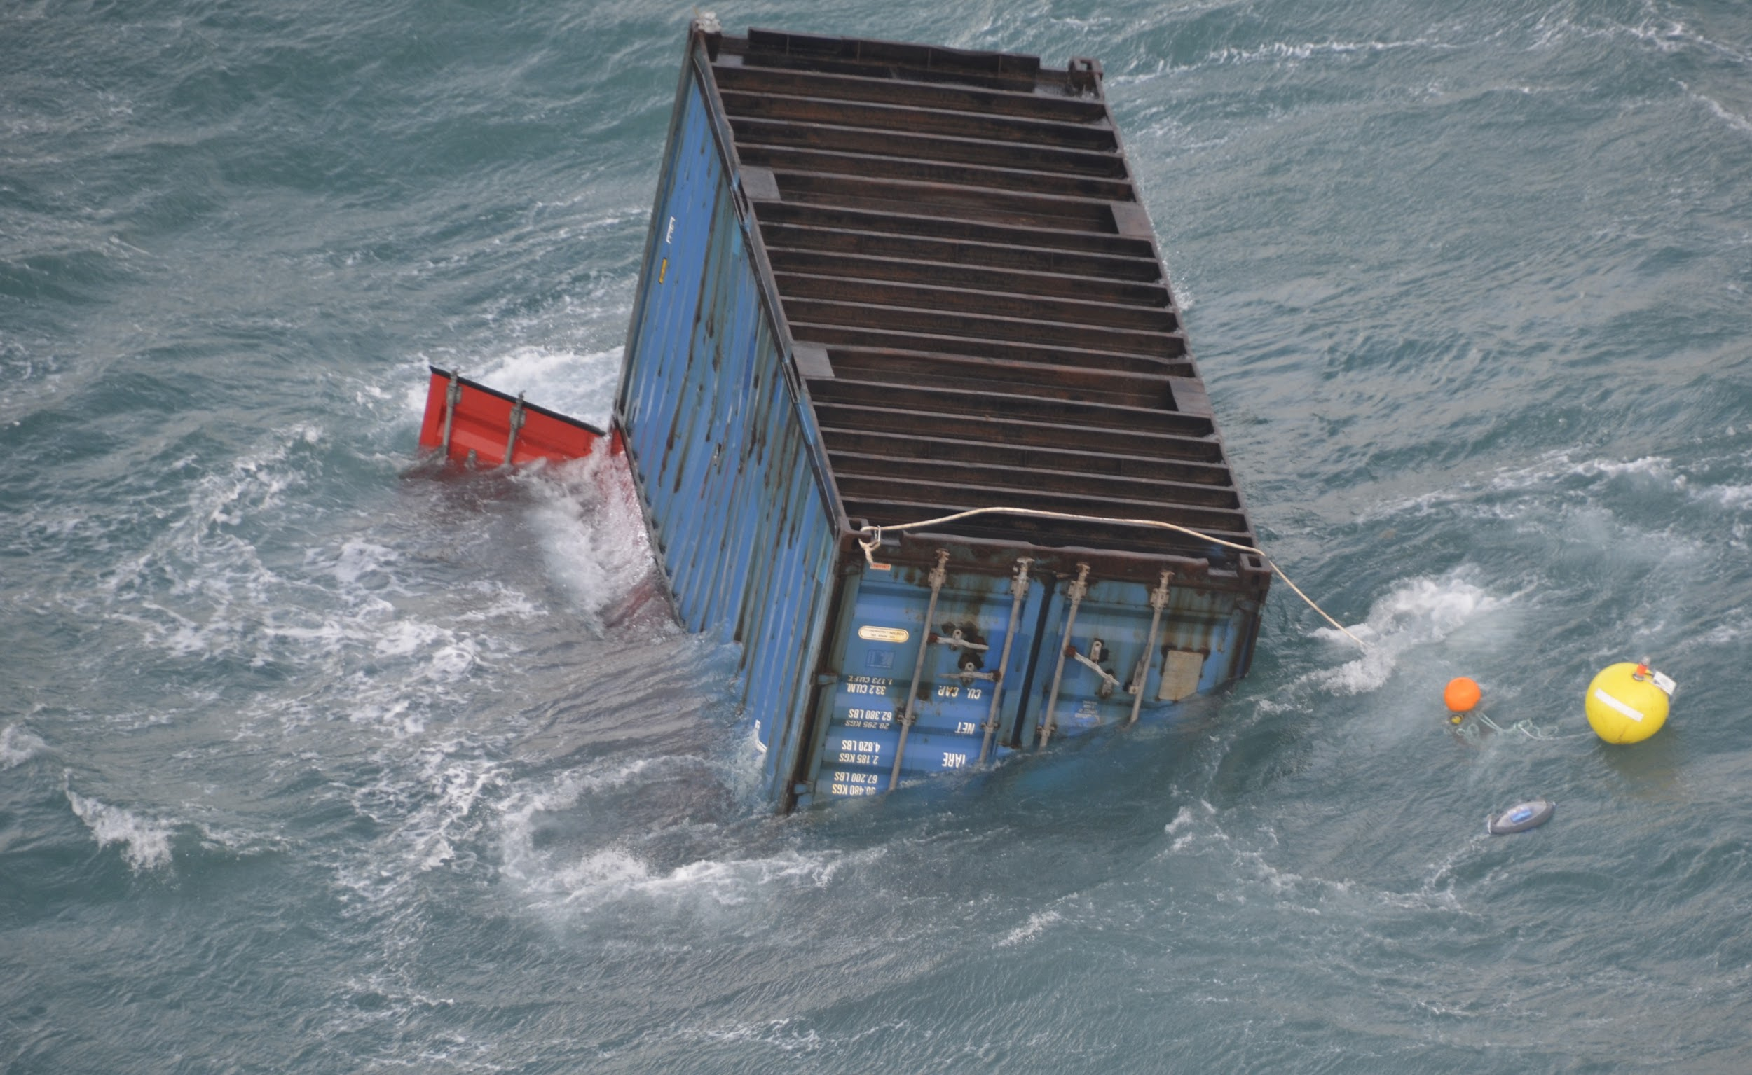
Notes:
Fazer uso de containers em um ambiente de VM usando uma ferramenta de configuração como Chef ou shell scripting também é comum, principalmente para desenvolvedores ou para testes de caso de uso. De qualquer forma, o ponto principal é a aplicação e se essa aplicação está no container existem alguns problemas bem comuns de acontecerem.

Slide 8
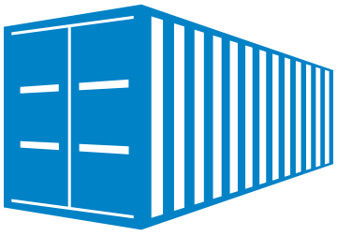
WHY THIS CONTAINER DIED?
Troubleshooting
What to do?

Slide 9
WHY THIS CONTAINER DIED?
TROUBLESHOOTING STEPS
# Docker events, container logs
# Enable Debug
/etc/docker/daemon.json
{...
"debug": true
}
# journalctl -u docker.service > docker-logs.txt
# bzip2 dockerd.`pgrep -f dockerd`
# bzip2 containerd.`pgrep -f docker-containerd-current`
Notes:
If you had your containers crashing you want to check docker events and the container event itself, try to interact and debug the container from the inside. But many other times, the container get killed, and for those, dockerd or containerd service logs and core dumps are very helpful.

Slide 10
WHY THIS CONTAINER DIED?
Set system-preserved/kube-preserved
Set Max Heap memory(-Xmx) (Java apps)
Set Limit Memory (container)
Set CPU Quota
HOST
RESOURCES
Notes:
What is PLEG? PLEG relies on relisting for discovering container events. It uses the list of pods it has and makes calls to the container runtime. PLEG lists not healthy when the relist takes more than 3 minutes. Those not healthy scenarios, may happen due lack of resources and a common scenario to have those happening are to ‘huge’ clusters with too much resource with huge amount of containers.

Slide 11
WHY THIS CONTAINER DIED?
Set system-preserved/kube-preserved
Set Max Heap memory(-Xmx) (Java apps)
Set Limit Memory (container)
Set CPU Quota
HOST
RESOURCES
UNREASONABLE NUMBER OF PODS
HAVE REASONABLY-SIZED NODES INSTEAD OF LARGER NODES.

Slide 12
WHY THIS CONTAINER DID NOT DIE?
Troubleshooting
What to do?

Slide 13
WHY THIS CONTAINER DID NOT DIE?
Common message:
# docker rm f6e8XXXX
Error response from daemon: Driver devicemapper failed to remove root filesystem f6e8XXXX: failed to remove device ba1b29XXXX:devicemapper: Error running DeleteDevice dm_task_run failed
Common symptom: Not able to delete containers
Notes:
In the container-deleting process, we delete the thin device first and then delete the metadata. So if docker is killing between these two actions. we get this.

Slide 14
WHY THIS CONTAINER DID NOT DIE?
Possible causes:
Forced Removals
No GarbageCollector
Notes:
GARBAGE COLLECTOR: Deletion of unused digests of docker images to avoid unnecessary space growth in a private docker registry
Garbage collection is the process of removing blobs from the filesystem when they are no longer referenced by a manifest. Blobs can include both layers and manifests.
As long as a layer is referenced by one manifest, it cannot be garbage collected.

Slide 15

WHY THIS CONTAINER *DID NOT* DIE?
Troubleshooting steps:
Check if the mount exist for dead containers.
$ docker inspect 58aaf158d234 | grep -i devicename
"DeviceName": "docker-253:1-12345678-987654321...
$ df -hTP | grep -i 987654321...
$ ls -ltr /var/lib/docker/devicemapper/mnt/
$ ls -ld /var/lib/docker/devicemapper/mnt/* | wc -l
Notes:
When a container is in Dead status, means that it cannot be removed. Mostly is because there is an underlying mount point that cannot docker cannot release.Docker does not remove volumes by default if containers are removed (docker rm). That means either users need to use option "-v" during "docker rm" to remove volumes also. Otherwise volumes will remain on the system and consume space.
- What to do? Evacuate the node, delete the mount locations of dead container, restart service.

Slide 16
WHY THIS CONTAINER *DID NOT* DIE?
Troubleshooting steps:
2. Check if there are PIDs related
$ grep -l 58aaf158d234 /proc/*/mountinfo
# kill -9 8441
# docker rm 84e111dc4717

Slide 17

WHY THIS CONTAINER IS SO SLOW?
Use cases
Possible causes
What to do?

Slide 18
WHY IS IT SO SLOW?
Common symptom:
Slow builds
Slow pull/push
Notes:
The container itself slow is usually related to the process/application, or even just the whole host being slow/overloaded.
Builds may be slow for the same reasons, or they could be slow because of the way they're built
Push/pulls to registries will usually be network issues on host and/or registry

Slide 19

WHY IS IT SO SLOW?
PULL/PUSH - possible causes
Push/pulls to registries will usually be network issues on host and/or registry
Rare, but possible.
MTU
Check dockerd logs.

Slide 20
WHY IS IT SO SLOW?
PULL/PUSH
Use case:
Pulling images via docker is very slow. The hang seems to be at the end of the Extracting layer step. High IO wait spikes seen since the server was enabled in the cluster.
What happened?

Slide 21
WHY IS IT SO SLOW?
PULL/PUSH
Use case:
Pulling images via docker is very slow. The hang seems to be at the end of the Extracting layer step. High IO wait spikes seen since the server was enabled in the cluster.
Questions:
Is reproducible?
Have you checked your network settings?
Network limits?

Slide 22
WHY IS IT SO SLOW?
PULL/PUSH
Use case:
Pulling images via docker is very slow. The hang seems to be at the end of the Extracting layer step. High IO wait spikes seen since the server was enabled in the cluster.
What happened?
Confirmed this is a storage issue. Our new nodes are capped at 500 IOPS on the docker-vg LUN, while the old servers have no cap

Slide 23

WHY IS IT SO SLOW?
SLOW BUILDS
Image sizes
Image layers(Dockerfile)
Storage graph drive
Notes:
The container itself slow is usually related to the process/application, or even just the whole host being slow/overloaded.
Builds may be slow for the same reasons, or they could be slow because of the way they're built

Slide 24
WHY IS IT SO SLOW?
BUILD
Use case:
Docker build should complete quickly instead of minutes. But WE noticing that the docker build on this host is taking around 3 minutes(2m 57 sec). I do see the same behavior on my test environment as well.
What happened?

Slide 25
WHY IS IT SO SLOW?
BUILD
Use case:
Docker build should complete quickly instead of minutes. But WE noticing that the docker build on this host is taking around 3 minutes(2m 57 sec). I do see the same behavior on my test environment as well.
What happened?
This same Dockerfile when used on a Docker host configured with Overlay2, build process completes between 7 to 10 seconds.

Slide 26
WHY SO MANY
STORAGE ISSUES?
Devicemapper vs Overlayfs
Use Case
Troubleshooting/What to do?

Slide 27
Storage Graph Driver
Docker images = immutable layers.
A driver is needed to mount these layers into a consolidated root filesystem for the container.
Given the “image graph” of layer content represents the relationships between various layers, the driver to handle these layers is called a “graphdriver.”

Slide 28
DeviceMapper in builds
Creates dm snap devices for the intermediate containers during the build process on the existing pool
Mounts it
Performs operation on top of device, unmounts it (invalidates caches, operation is little expensive)
Checks if the dm device deletion is successful.

Slide 29
Overlay2 in builds
Allows to share pagecache while dm snap does not.
  Multiple containers accessing the same file share a single page cache entry for that file.
Efficient with memory and a good option for high-density use cases such as PaaS.

Slide 30
WHY SO MANY STORAGE ISSUES?
Use case:
$ docker pull registry/local/image:1.1.7
Trying to pull repository registry/local/image ...
280aca6ddce2: Already exists
[...]
ae99fcdd96d4: Download complete
failed to register layer: devmapper: Unknown device 31b764f7cf....b27aa4d66
Notes:
MAYBE MAYBE a DANGLING REFERENCE to MISSING DEVICE?!a DANGLING REFERENCE to MISSING DEVICE?!

Slide 31
WHY SO MANY STORAGE ISSUES?
Use case:
$ docker pull registry/local/image:1.1.7
Trying to pull repository registry/local/image ...
280aca6ddce2: Already exists
[...]
ae99fcdd96d4: Download complete
failed to register layer: devmapper: Unknown device 31b764f7cf....b27aa4d66
POSSIBLE CAUSE:
MAYBE a DANGLING REFERENCE to MISSING DEVICE?!

Slide 32
WHY SO MANY STORAGE ISSUES?
Troubleshooting - What to do?
Investigate references
$ sudo tar czpf docker-metadata.tgz /var/lib/docker
Notes:
No /var/lib/docker, você consegue ver se existe alguma referência pendente para um device que esteja faltando no device-mapper metadata.

Slide 33
POR QUE ESSE CONTAINER NÃO RODA?
HÉVELLYN GOMES
THANK YOU!
TRILHA CONTAINERS
WHY THIS CONTAINER DOES NOT RUN?
/hevellyngomes
hevellyn.nlg@gmail.com

Slide 34
POR QUE ESSE CONTAINER NÃO RODA?
HÉVELLYN GOMES
TRILHA CONTAINERS
WHY THIS CONTAINER DOES NOT RUN?
REFERENCES
https://kubernetes.io/docs/setup/cluster-large/
https://kubernetes.io/docs/tasks/administer-cluster/reserve-compute-resources/
https://blog.openshift.com/full-cluster-part-2-protecting-nodes/
https://cloud.google.com/blog/products/gcp/kubernetes-best-practices-resource-requests-and-limits
https://dzone.com/articles/kubernetes-resource-usage-how-do-you-manage-and-mo
https://docs.docker.com/storage/storagedriver/overlayfs-driver/
https://docs.openshift.com/container-platform/3.11/scaling_performance/optimizing_storage.html#comparing-overlay-graph-drivers
http://rafabene.com/2019/04/02/10-coisas-evitar-docker/

