Slide 1
Report Portal: IA e Reports fTW!

Slide 2



Hello!
I am Ramses Almeida
I am here because i love to give presentations (more bacon)
and i working at @
You can find me at @rsaccoll
Or https://www.linkedin.com/in/rsaccoll

Slide 3
Who likes reporting here?

Slide 4


Slide 5
How to unify reports of multiple projects in one place?

Slide 6

Let's do it from scratch!... using elasticsearch

Slide 7


Slide 8


Slide 9
There must be something ready to use on the internet

Slide 10
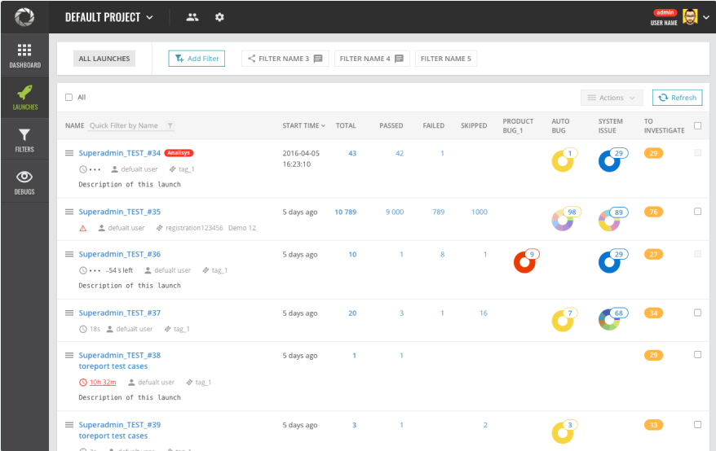

Slide 11


Slide 12
Report Portal
AI-powered Test Automation Dashboard
Manage all your automation results and reports in one place.
Visualize metrics and analytics
Major test frameworks
Microservice architecture
First-class docker support

Slide 13
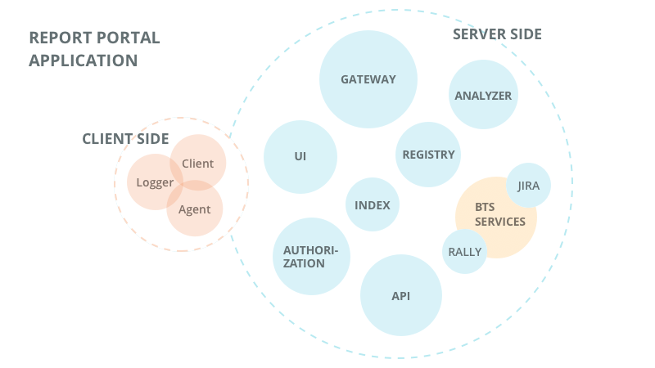
Report Portal

Slide 14
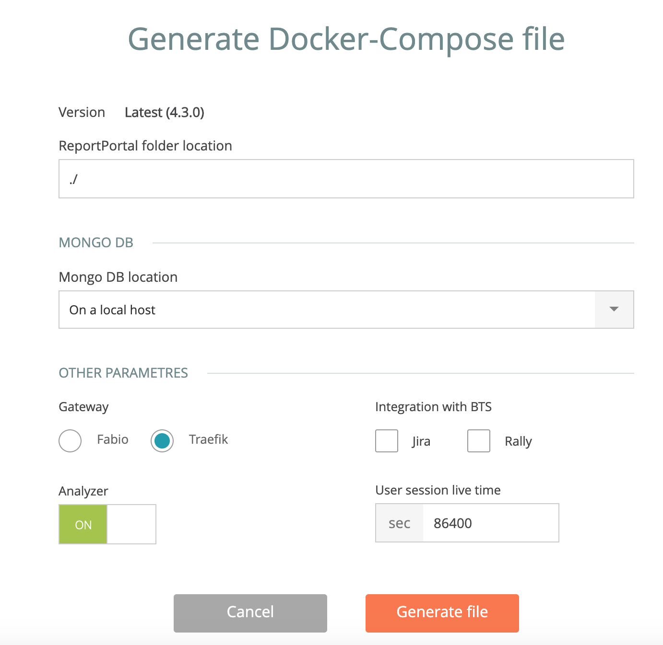
Report Portal
Has a docker-compose.yml ready as use. Or …

Slide 15
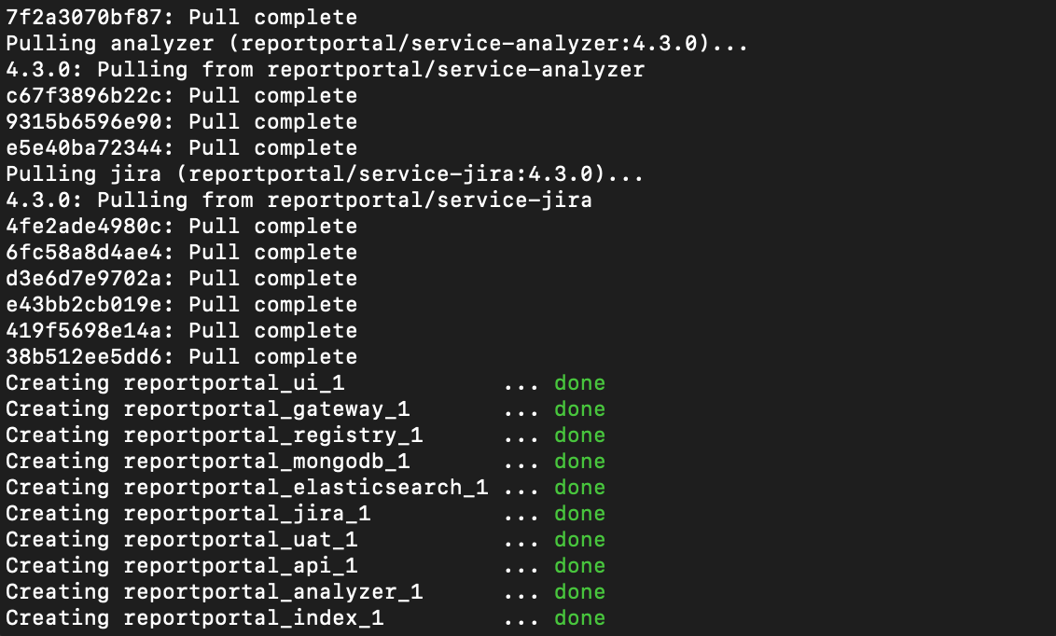
docker-compose -p reportportal up -d --force-recreate

Slide 16
warning!
ElasticSearch -
Analyzer: set {vm.max_map_count}
mkdir data/elasticsearch
chmod g+rwx data/elasticsearch
chgrp 1000 data/elasticsearch

Slide 17
Go to : http://localhost:8080/ui/

Slide 18
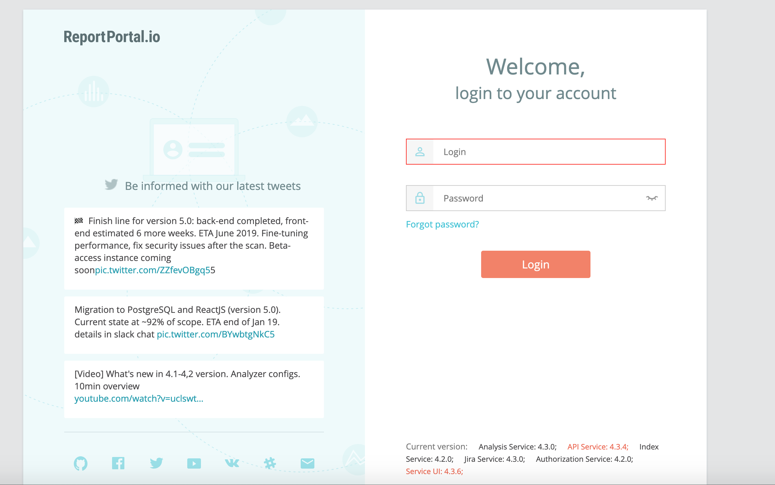

Slide 19
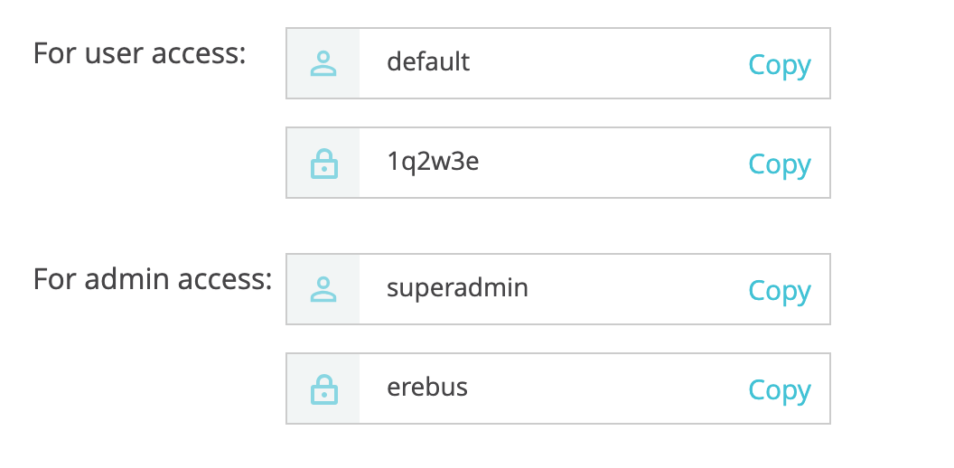
https://web.demo.reportportal.io/ui/

Slide 20
AND
That's it?
Just starting using e have some fun??

Slide 21


Slide 22
Report Portal

Slide 23

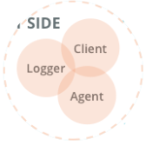

Slide 24
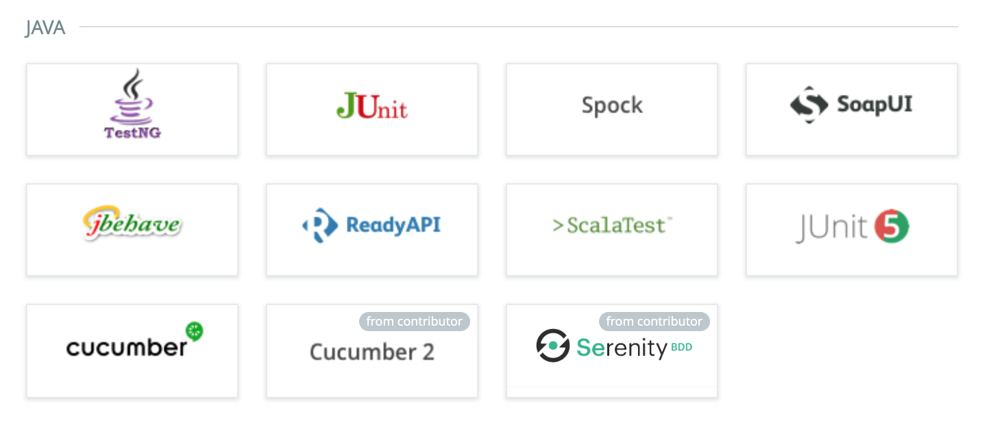
Pick Your Poison

Slide 25

Pick Your Poison

Slide 26
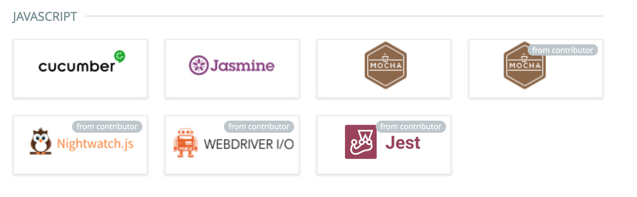
Pick Your Poison

Slide 27

Pick Your Poison

Slide 28

Pick Your Poison

Slide 29
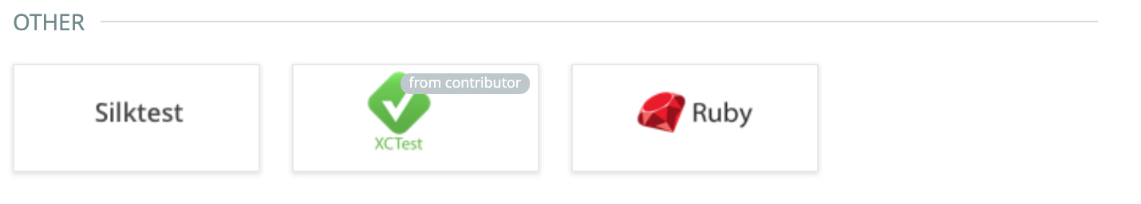
Pick Your Poison

Slide 30
Exemplo pratico

Slide 31

Links
http://shekup.blogspot.com/2018/08/installing-reportportal-on-aws.html
https://reportportal.io/download
https://reportportal.io/docs/What-is-ReportPortal?
https://github.com/richardsonlima/reportportal-k8s-aws-helm-chart

Slide 32
THANKS!
Any questions?
You can find me at @rsaccoll & https://www.linkedin.com/in/rsaccoll

Slide 33


