Slide 1
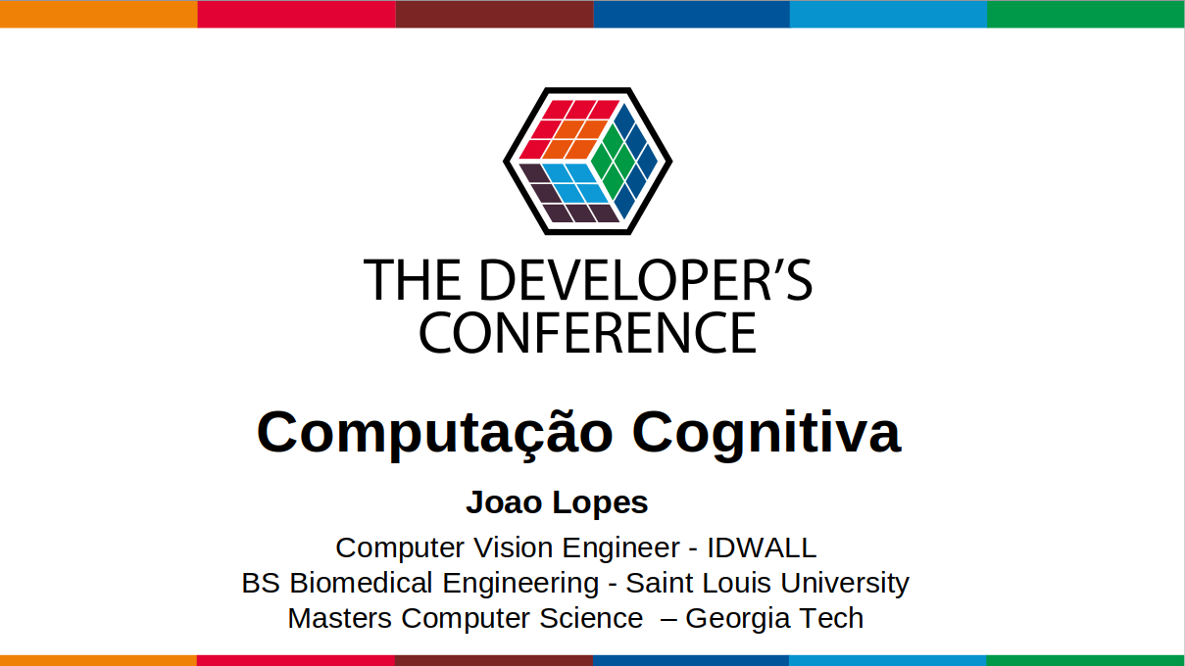
Nome Sobrenome.
Time time time time time time.

Slide 2
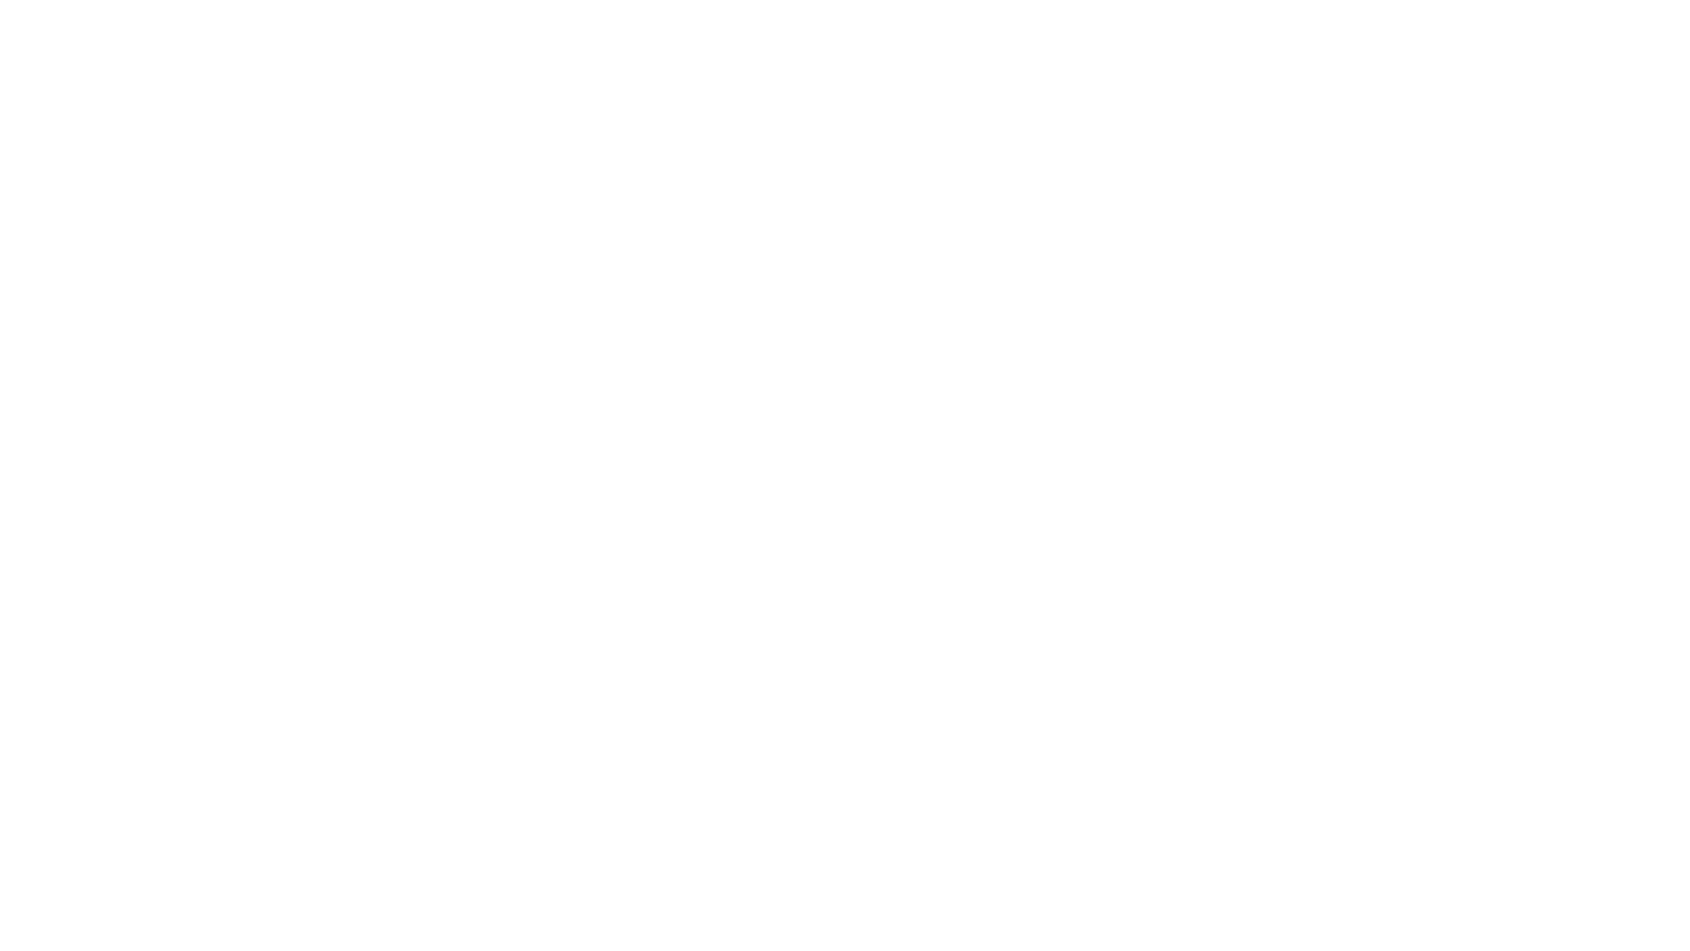
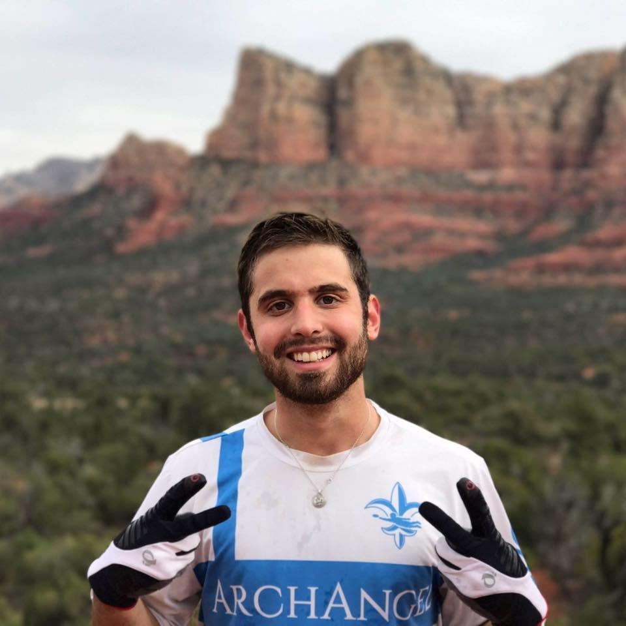
About Me
Graduated St. Louis University with a BS in Biomedical Engineering
Currently doing my masters in Computer Science at Georgia Tech
Work at Idwall with R&D, focus in computer vision
  We’re Hiring :)

Slide 3
Object Tracking In Computer Vision

Slide 4
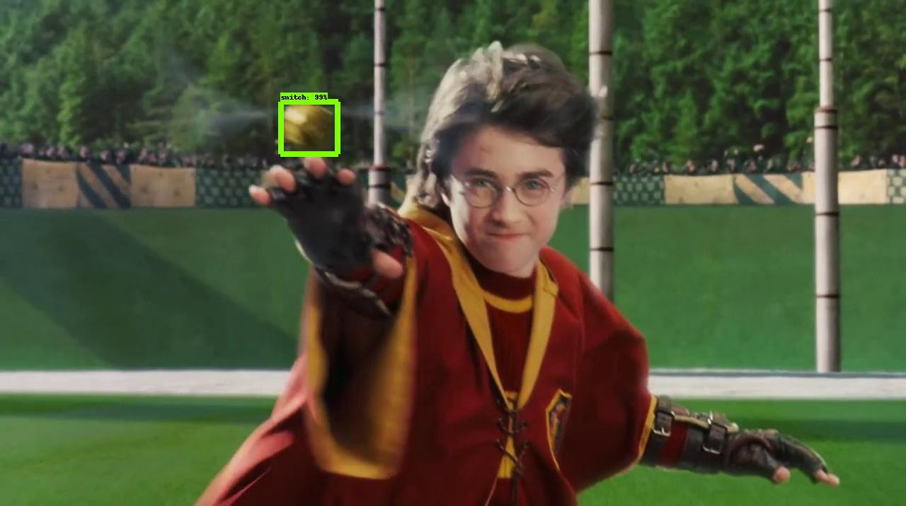
Detection Vs Tracking
Detection
Detect object independently in each Frame
Tracking
Predict the new location of the object in the next frame using estimated dynamics. Then update based upon measurements.
Restricts Search
Get improved estimates since measurement noise is tempered by priors
Makes the assumption of continuous motion

Slide 5
What is it?
Tracking
Given a Model of expected motion, predict where the object will occur in the next frame, even before seeing the image
Restrict Search for the object
Improved estimates since measurement noise is reduced by trajectory smoothness
Challenges
Want to take dynamics into account
Errors compound
Occlusion and Disocclusion

Slide 6
Different Methods
Kalman Filter
Particle Filter
Deep Learning
Others
1
2
3
4
Method for tracking linear dynamic system with Gaussian noise.
Method of tracking that uses a set of particles/samples to represent the posterior distribution of some stochastic process.
Use of CNN for object detection and tracking
Mean shift
Bayes Tracking
SVM
Template Matching
Etc..

Slide 7
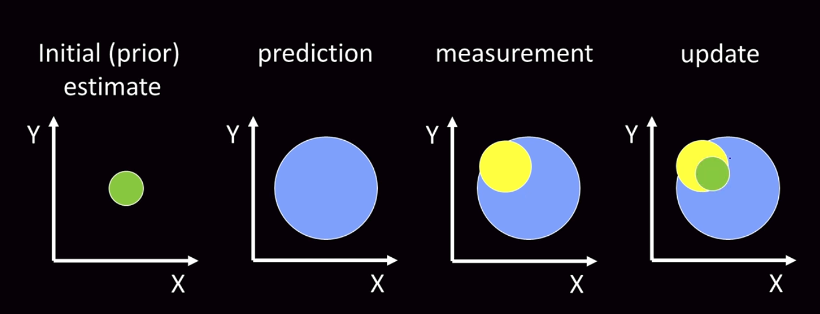
Kalman Filter

Slide 8
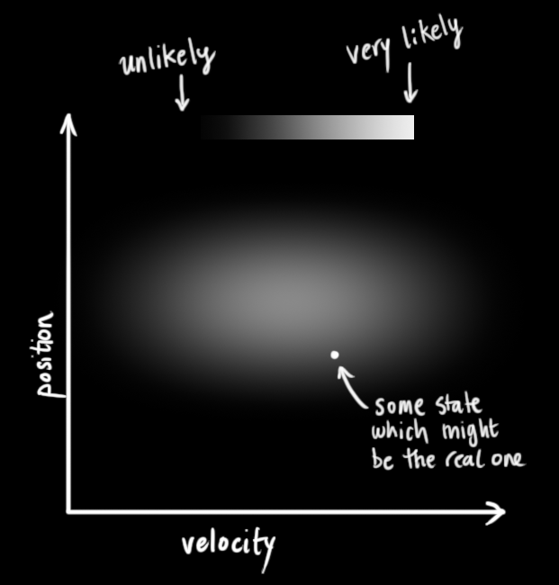
Assume we have a simple state, defined by position and velocity. We don’t know the actual position and velocity, be we know the range
Data
https://www.bzarg.com/p/how-a-kalman-filter-works-in-pictures/

Slide 9
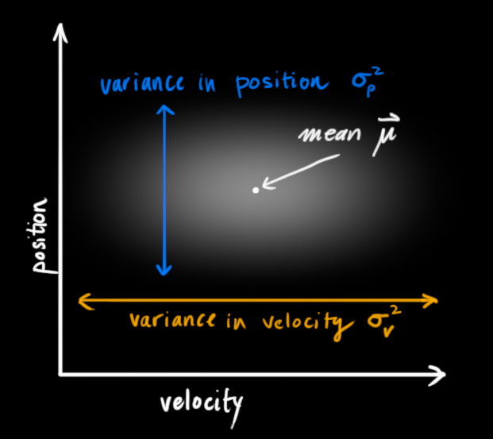
Data
For a Kalman Filter to work, we must assume our measured variables are random Gaussian’s.

Slide 10
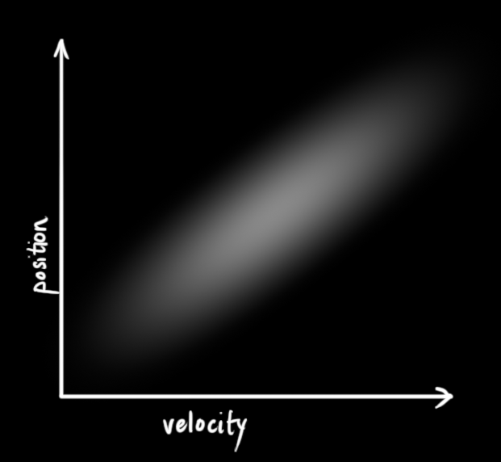
Previous slide we defined position and velocity as uncorrelated. But we know that both are actually correlated.
Data

Slide 11
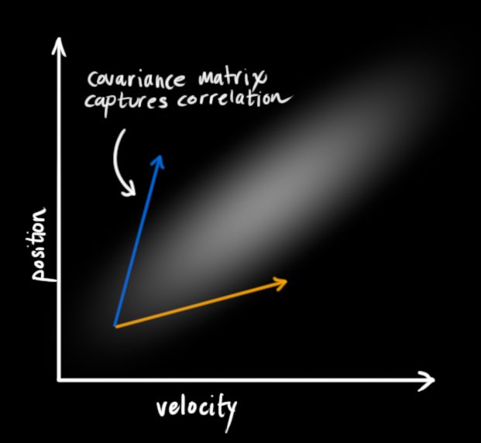
The correlation is captured by the co-variance matrix.
Data

Slide 12
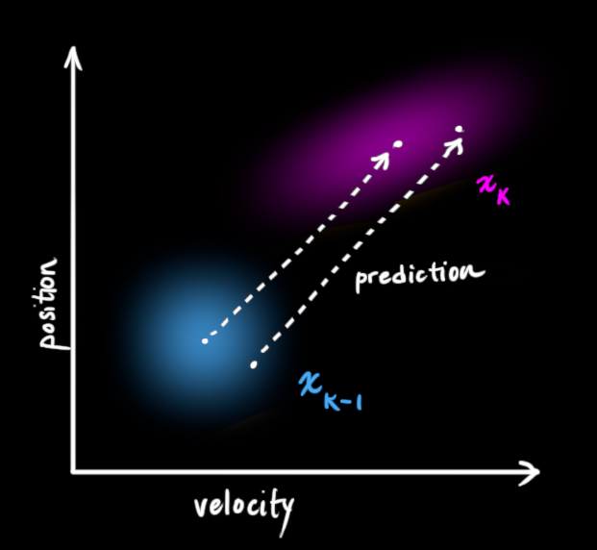
The kalman filter works by taking the current state, and predicting the next state.
Predict

Slide 13
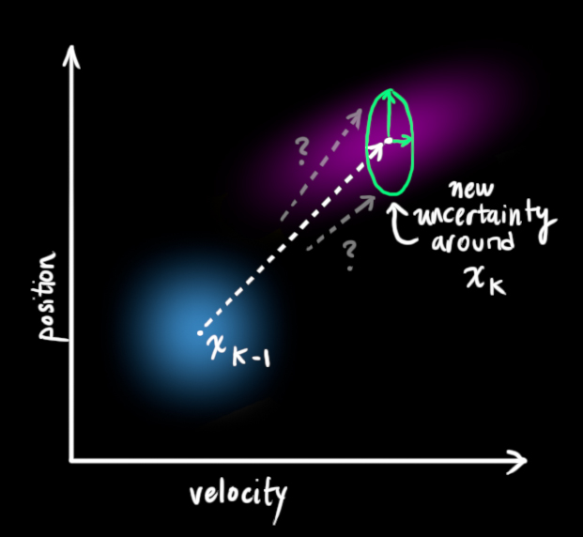
Since we can’t account for every variable, we add uncertainty to our measurements
Predict

Slide 14
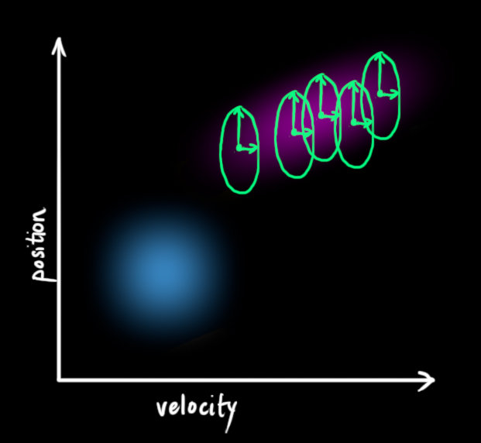
Every state can be moved to a range of states, which can be defined by a Gaussian with a set co-variance
Predict

Slide 15
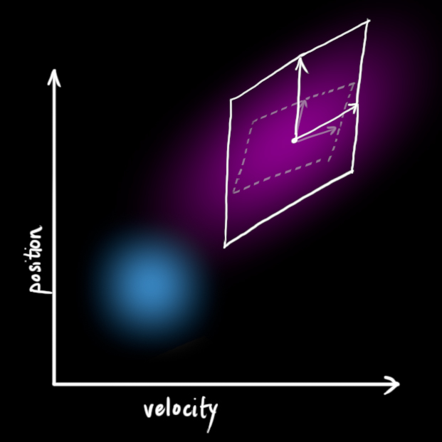
This produces a new Gaussian, with greater co-variance
Predict

Slide 16
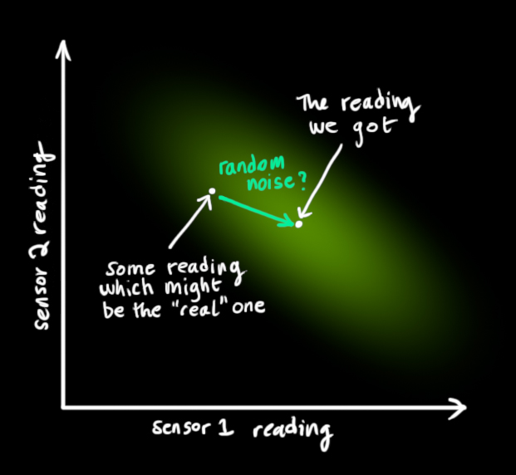
Measure
Next we take into account the measurement from the sensors. Which has a given mean and variance

Slide 17
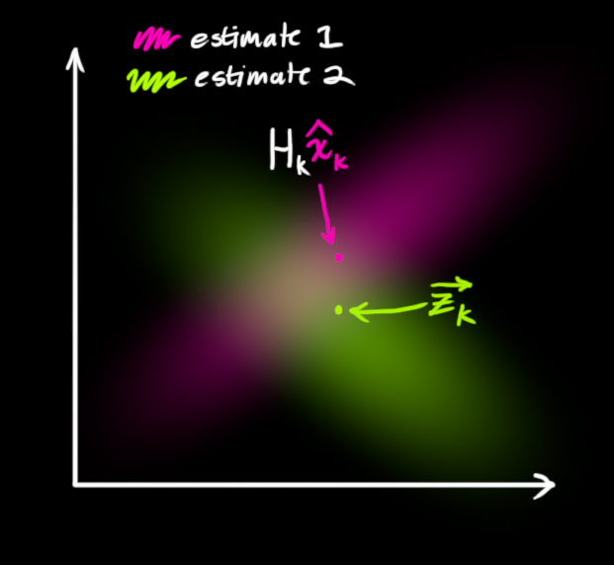
Update
With the sensor reading, and our estimate, we are left with two Gaussian
Since we have two distributions, we can multiple them together to obtain correction

Slide 18
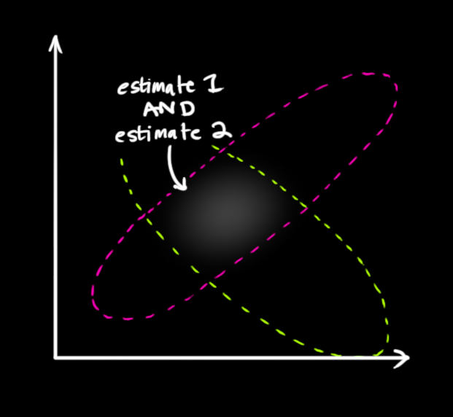
Update
The best estimate comes from the overlap.

Slide 19
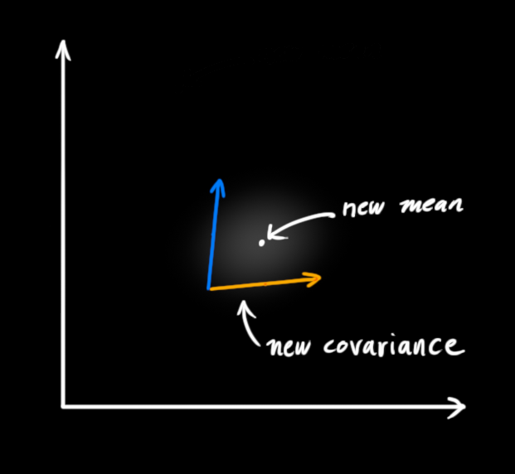
Update
Which also happens to be a Gaussian Meaning we can do this process all over again.

Slide 20
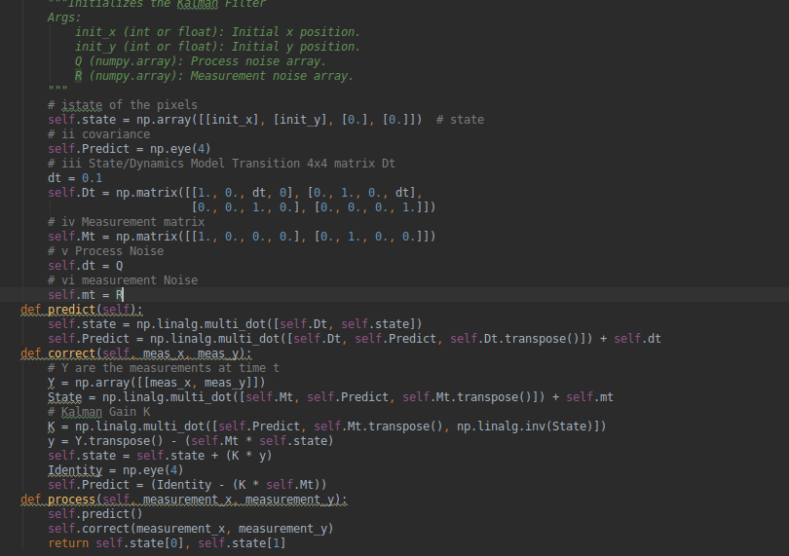
Code Snippet

Slide 21
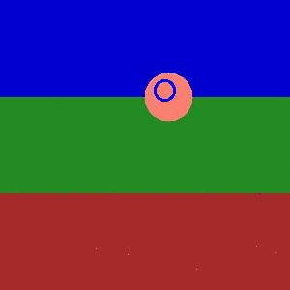
Simple Kalman Filter

Slide 22
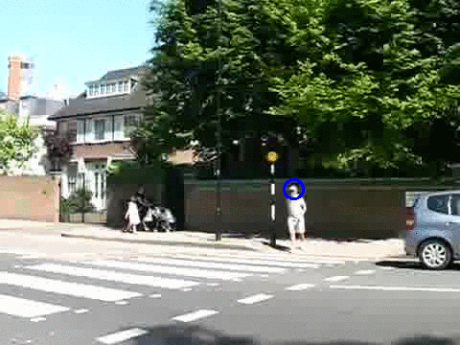
Kalman Filter Tracking Pedestrian

Slide 23
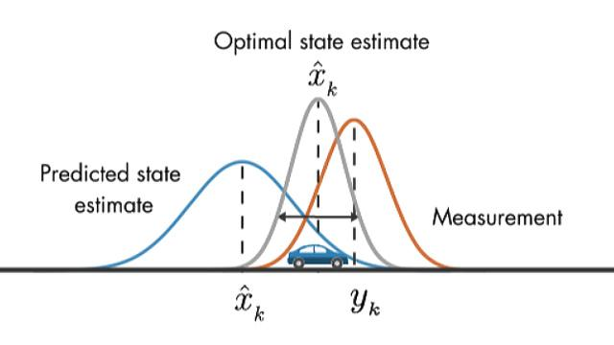
https://www.mathworks.com/videos/understanding-kalman-filters-part-3-optimal-state-estimator--1490710645421.html

Slide 24
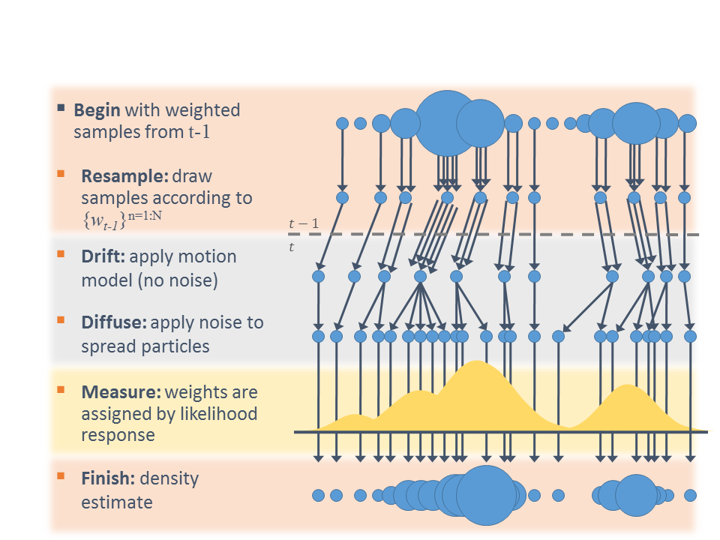
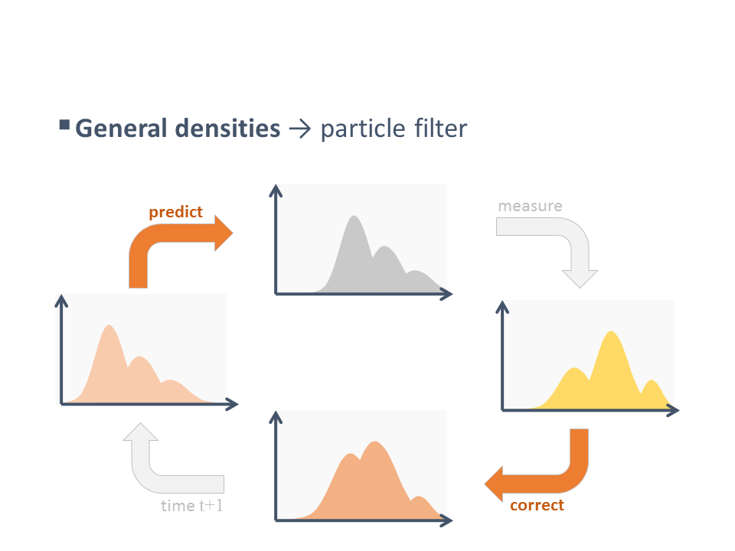
Particle Filter
https://www.codeproject.com/Articles/865934/Object-Tracking-Particle-Filter-with-Ease

Slide 25
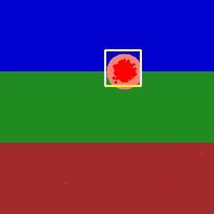
Simple Particle Filter

Slide 26
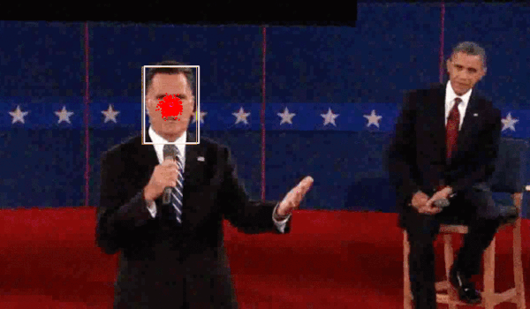
Particle Filter Noisy video

Slide 27




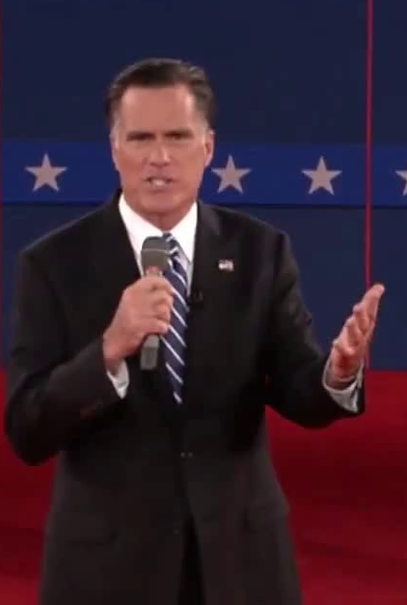






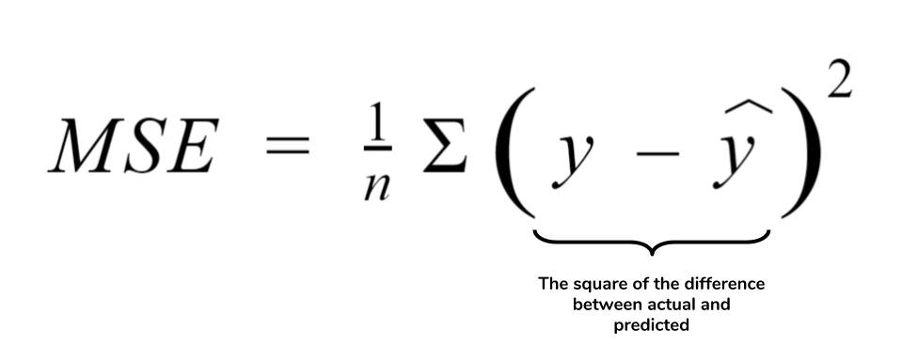
Define Particles
Create Templates
Calculate Error/Weights
Resample

Slide 28
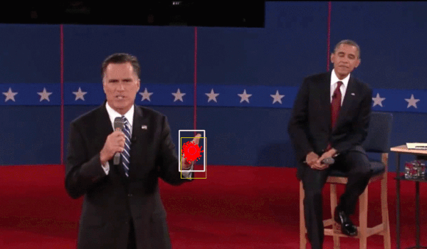
Particle Filter With Changes in Appearance

Slide 29

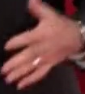
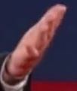

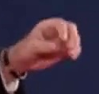
How to Handle Changes in Target?

Slide 30
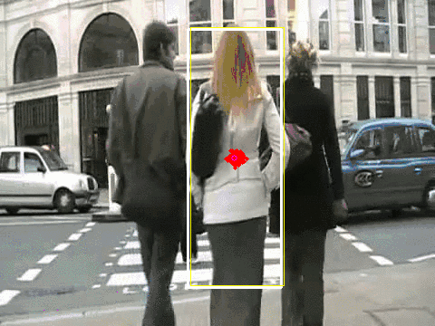
Particle Filter With Occlusion

Slide 31
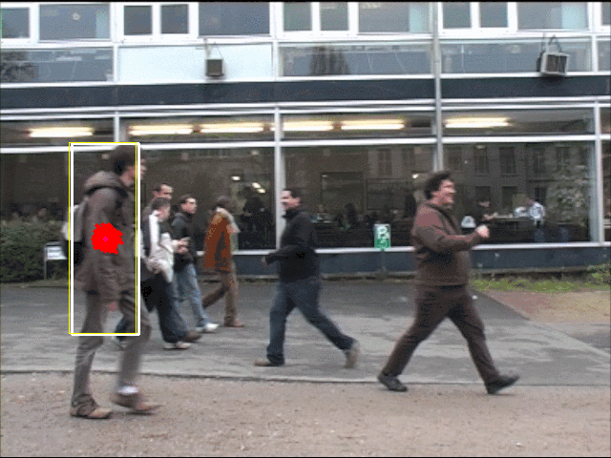
Particle Filter with Multiple Targets

Slide 32
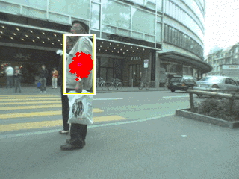
Particle Filter with Moving Camera

Slide 33
Why not just use deep learning?
Knowing what’s happening is sometimes necessary
Being able to explain when things fail is also important
You can always combine with deep learning detection algorithms
The more closed off the context, The easier it is to apply deep learning successfully

Slide 34
Perguntas!?

Slide 35


